Slide 1
Software Process Improvement
An Introduction

Slide 2
Industry Reported Cost
1995, The Standish Group
Industry Project Facts: 1995
  31.1% of all projects were cancelled before they completed
  52.7% of projects cost 189% of their original estimates
  Only 7% of projects longer than 6 months completed on time and within budget
  The cost for IT projects in U.S. Companies and in the Government that were cancelled before implementation in 1995 is estimated at $81 billion dollars

Slide 3
Industry Reported Cost
B. Boehm, IEEE Tutorial on Software Risk Management, IEEE CS Press
Los Alamitos, Calif., 1989.
The cost of rework on large scale projects has typically consumed 40 to 50 percent of the total software development budget.

Slide 4
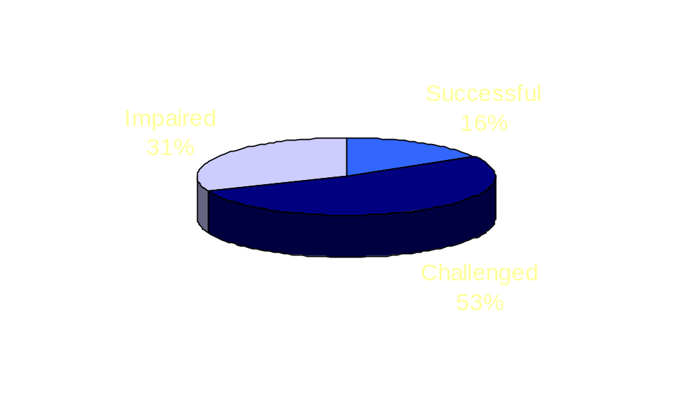
The Chaos* Study
Conducted by the Standish Group International, Dennis, MA (USA)
Annual Expenditure for Software Development in the
United States: $250 Billion
Successful - $40 billion
Challenged - $132.5 billion
Impaired - $ 77.5 billion
Successful = On budget, on time, with all functions; Challenged = over budget, delayed, with fewer functions than planned; Impaired = cancelled in development

Slide 5

Causes of Failure
Incomplete Requirements
Poor Estimating
Changing Requirements
Lack of Planning
Lack of User Involvement
Lack of Resources
Lack of Executive Support
Obsolete before it is complete
Unclear Objectives & Requirements
New Technology
No Team Commitment
Lack of IT Management Oversight
Technology Incompetence
Does not solve business problem
Unrealistic expectations and schedules
Lack of Project Management training.

Slide 6
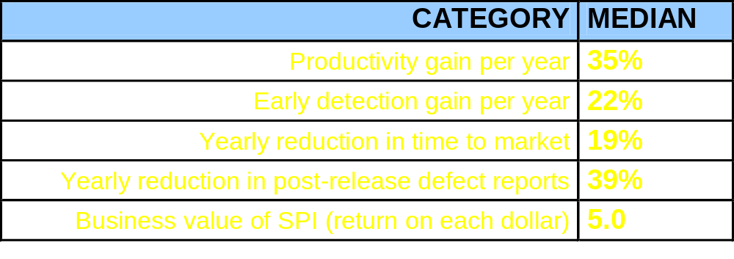
Cost-Benefit
CMU/SEI-94-TR-013
Data collected from organizations at a variety of maturity levels who embarked on Software CMM-based improvement efforts:

Slide 7
Introduction to SPI
Process Improvement Concepts

Slide 8
A Definition of Software Process
" . . . Software process can be defined as a set of activities, methods, practices, and transformations that people use to develop and maintain software and the associated products (e.g., project plans, design documents, code, test cases, user manuals, etc.)"
[Source: SEI technical report SEI-93-TR-24, "Capability Maturity Model for Software"]
Notes:
Process is what you do (the steps you follow, your project follows, or your organization follows) to develop and maintain software.
A common understanding and agreement about the existing process enables groups of professionals and technicians to work together as a team
Documented processes should contain at a minimum:
Entry Criteria: What are the preconditions for beginning the process?
Task Description: What steps are needed to complete the task? Note that some of those steps will themselves be described in separate process definitions.
Validation Criteria: How will the adequacy of the work be determined? Applicable standards, adherence to operating instructions, etc., are typically cited here
Exit Criteria: What are the post conditions for this process? What must be true before this work is considered complete? How has the “world” changed as a result of successfully completing this process?
Each process definition at each hierarchical level (i.e., Organizational or Project) must take into consideration the people, the tools, and the procedures.
Activities include:
Requirements Analysis
Designing
Coding
Documentation <Technical Practices>
Module Testing
Integration Testing
Systems Testing
Acceptance Testing
Installation
But they also include software support functions such as:
Project Planning and Tracking
Software Quality Assurance
Software Configuration Management <Management Practices>
Metrics definition, collection, and analysis
Training
Standards, Policies, and Procedures

Slide 9
Alternate Definition of Process
The means by which people, procedures, methods, equipment, and tools are integrated to produce a desired end result.
B
A
D
C
Relationships
of all tasks
PROCESS
Skills,
Training,
Motivation, &
Management
Tools and
Technology
Notes:
People: Must have the skills, training, and motivation necessary to do the work. They must be managed in a way that will increase their effectiveness.
Tools and Technology: Must be selected to promote effective and efficient software engineering principles and practices. Tools must work together with the process to enhance quality and productivity. Personnel must be trained in their use. Tools must be selected to complement the software process
Relationships The relationships among these components must be managed in order to achieve maximum progress.
To be effective, a process must provide the framework for integrating people, tools and technology, and complex development and support activities - It is the glue that holds it all together
The core process must be tailorable to meet the specific needs of the individual projects
The process helps to describe the relationship of all of the tasks or activities mentioned before. How much quality assurance or configuration management is needed for a particular project? Obviously if you are the quality manager for the Space Shuttle project and you must sign a statement that there are no known quality defects in the system, before each launch, you would like a very rigid process that can guarantee that type of success. On the other hand, if you are building software for a computer game, the quality issues may not be so critical

Slide 10
Process in Perspective
People
Process
Technology
Major determinants of software cost,
schedule, and quality performance
Notes:
Today there is a lot of talk and focus on Process Improvement. In the past decade, the emphasis was on Tools and Technology.
The focus on Process today does not mean that Tools and Technology are not important or that with a good process and good tools an organization does not need good people.
The message is that proper emphasis must be placed on all three areas of people, process and technology.
This concept can be represented by a few examples:
Three-legged stool - If you cut one of the legs in half the stool will no longer be stable enough to sit on.
If you view the figure above as a triangle held together with link pins - then if you take one of the link pins away the structure collapses. If you put too much pressure on one of the link pins the structure may deform or become unbalanced.
One should expect that a change to any one of the three will require appropriate changes in the others to maintain the desired balance
Viewing the structure as a triangle, one should observe that the base of the triangle is composed of process and technology and this base is supporting the top of the triangle which is the people.
The process and technology that an organization uses should support the most important asset - People - so they can be the most creative and productive possible

Slide 11
Factors Determining Software Process
Custom /
Culture
Policies
Standards
Technology
Financial
Constraints
Contractual
Obligations
Notes:
There are many factors which must be taken into consideration when an organization is trying to establish its organizational process - The ones shown here are but a few of the ones that have been critical for organizations who have started their process improvement programs in the past 8 years:
Policies - Describes how the management expects the organization to go about its daily business of developing software. A policy can be thought of as a reflection of Senior Management’s attitude toward (quality, planning, requirements management, subcontractor control, etc.)
Custom/Culture - Factors that not only affect the development and maintenance of software but also affect the everyday morale and fiber of the work force
Example - Dave Packard of Hewlett-Packard was wandering through the halls of HP very late one night and found himself at the hardware lab. He wanted to see what his engineers were doing. He found the doors were locked and became greatly frustrated. He wrote a memo issuing an edict immediately stating that all Lab doors were to remain open to allow access to all engineers who might want to wander by and get some ideas from his colleagues.
Standards - What standards are the organization required to comply with :
DoD-STD-2167A
ISO 9001; ISO 9000-3
IEEE standards
Capability Maturity Model
Contractual Obligations- What is spelled out in the statement of work? What has been agreed upon with the customer?
Financial constraints - What is the competition doing?
What is the customer willing to pay for?
What activities can you afford to do?
Technology - Does the technology and/or tools complement the defined process? Each tool especially Case Tools have an underlying process built into them. With each tool that you buy you are accepting this underlying process along with the tool. Soon you may have ‘patchwork’ process. The tools and technology chosen should complement the defined process.

Slide 12
Process Improvement Relevance to CMM Study
The purpose of the CMM is to provide a roadmap for process improvement
Understanding the challenges of successfully changing organizations gives added insight into how and why the CMM is structured
If changing organizations were easy, the CMM would be unnecessary
Notes:
The CMM provides the roadmap for software process improvement programs. It guides the technical and social activities that institutionalize the process throughout the organization.
The CMM is the ‘backdrop’ for assessment and improvement - It does not guarantee or even suggest that following the CMM will help make the “Changing Process” any easier.

Slide 13
Principles of Process Change
Major changes must be sponsored by senior management
Focus on fixing the process, not assigning the blame
Understand current process first
Change is continuous
Improvement requires investment
Retaining improvement requires periodic reinforcement
sponsored
fixing
Understand
continuous
investment
reinforcement
Notes:
Major changes must be sponsored by Senior Management
Management owns the process. Without management support from the top, change is slow if not impossible to realize. Management must set challenging goals, provide the necessary resources, monitor progress, and insist on performance
Focus on fixing the process, not assigning the blame
People work within the given process.
It is important to constantly be on guard to focus on fixing recognized process problems and not focus on blaming individuals.
Recognize that people, by nature, desire to do good work. The focus on people causes resistance to change.
Understand the current process first
Before process improvement can begin, an organization must understand what process (defacto or otherwise) exists and is being followed.
Change is Continuous
Change must be accepted as a way of life. Reactive changes generally make things worse. Process improvement is not a one shot deal. An organization must create an environment that can be changed and in which people are secure as it changes.
Improvement requires investment
Process improvement is not a half-time job for one individual. Depending on the size and complexity of the organization, it may require many full time employees focused on on the task of process improvement.
Automation of an ill-defined processes will produce ill-defined results. Improvements should be made in small steps.
Training is expensive, but not nearly as expensive as not training.
Retaining improvement requires periodic reinforcement.
Again improvement is not a one shot deal. Senior management must periodically review process improvement in the organization.
Process groups must bring critical process problems to the attention of management.
Re-determination of where the organization's process is is necessary for continuous improvement

Slide 14
Building Support for Change
[courtesy JMaher]
Legitimacy
Support
Notes:
If Process Improvement equates to change then support for that change must exist at every level of management and at the practitioner level.
This diagram illustrates this point
For the process improvement to be legitimate, cascading management support must flow from the senior management level down to the first line supervisor and that support must be demonstrated to the practitioners
For the process improvement to be accepted support must be shown from the practitioners and reflected back up the management chain.
Exercise: Place two business cards over the second and third hierarchical blocks. All that should be showing is the top senior management block and the practitioner blocks at the bottom. On the overhead it should look rather black. Ask the participants what they think that is. The class answer is a ‘black hole’. If cascading management support is not achieved process improvement will probably be blocked.

Slide 15
Organizations As Systems
Organizational
System
Strategic
Subsystem
Technological
Subsystem
Managerial
Subsystem
Inputs:
Human,
Financial,
Technological,
Material,
Resources
Outputs:
Products
Services
Human/Cultural
Subsystem
Structural
Subsystem
Input-output flow of materials,
energy, information
[Source: Morgan, 1986]
Notes:
If we view the organization as a system, then changes to the organization implies change to each of those organizational components - separately and their inter-relationships
Strategic - Where does management want the organization to be 5 - 10 years from now?
Management - What direction (policies and procedures) does management provide to guide the organization in that strategic direction?
Technical - What processes and procedures need to be in place to achieve technical part of goals and strategy?
Social - How should people be organized and encouraged to interact with each other to enable technical results?
Structure - What environment (physical, automated) is needed to support social and technical change?
Understanding of these helps us to understand how process improvements work and where assessment fits into the Process Improvement Model

Slide 16
Managing Complex Change Requirements
Vision
Skills
Incentives
Resources
Action Plan
Change
Skills
Incentives
Resources
Action Plan
Confusion
Vision
Incentives
Resources
Action Plan
Anxiety
Vision
Skills
Resources
Action Plan
Slow
Change
Vision
Skills
Incentives
Action Plan
Frustration
Vision
Skills
Incentives
Resources
False
Starts
“Managing Technological Change”
Carnegie Mellon University
Software Engineering Institute
Notes:
If Senior management has provided the vision,The people needed to make the changes have the necessary training and skills
The necessary incentives are there for someone to make a change
All other resources, money, computers, etc., are available, and
A sound action plan has been developed and approved
Then the desired Change is possible and probable
If Senior Management has not provided the organization with his/her vision, even with all of the other factors in place
Then Confusion can result
If The people do not have the necessary training and skills to perform the required tasks
Then Anxiety may result
If The incentives to make a change are not present
Then the changes may take place but at a gradual, sometimes useless pace
If The necessary resources of money, computers, etc., is not made available, then Frustration results
If a sound action plan has not been developed and approved
Then many False Starts can take place

Slide 17
Introduction to SPI
Process Improvement Model

Slide 18
Process Improvement Model (PIM)
2
Appraisal
of the
Software Process
3
1
Infrastructure
and Plans for
Software Process
Improvement
Commitment
to
Software Process
Improvement
4
Implementation
of
Software Process
Improvements
Notes:
The ISPI Process Improvement Model is intended to show continuous process improvement. The main blocks of the model are:
Commitment to Software Process Improvement - The management team understands the process improvement process and commitments people, time, and other resources as needed toward its successful execution.
Appraisal of the Software Process - An appraisal of the organization’s software process takes place to determine what the current software process is (What is Documented and what is happening in the Practice).
Infrastructure and Plans for Software Process Improvement - The organizational software process improvement effort infrastructure is put into place and the action plans for the improvement effort are developed
Implementation of Software Process improvements - The actual implementation of the action plans takes place

Slide 19
PIM: Commitment
Activities
  Investigation and Training
    software process
    process improvement
    managing change
    team skills
  Expectation setting
    costs & benefits
    what is required of senior management?
    what is required of those who will be part of the process improvement effort?
    what other related efforts are already in place?
1
Commitment
to
Software Process
Improvement
Notes:
1) Commitment
• Investigation and training - Commitment to a new idea or process usually starts with some form of investigation. Books,articles, presentations, and internal discussion in some combination usually take place as the person or organization begin to understand and these new ideas
• Expectation Setting - One of the most important concepts in process improvement is that of Expectation Setting. It is ISPI’s belief that you can almost not put too much effort into expectation setting. This is true for all levels of management and practitioners.
What are the costs and benefits of committing

Slide 20
PIM: Commitment - 2
Activities
  Identification of key process improvement staff
  Visioning
    where do you want the company to be in one year or five years?
    where do you think the company will be?
    what do you think the culture will be then?
    who will be your competitors
  Sponsorship
1
Commitment
to
Software Process
Improvement
Notes:
1) Commitment - continued
• Identification of improvement staff - Qualified individuals should be identified for the process group (SEPG). Qualified individuals should be identified for the appraisal as well. It is wise to ensure that at least two of the appraisal members will remain as part of the SEPG for continuity
• Visioning - Where does senior management think the company will be in one year or five years? Who will the competitors be? Where will the company be ranked compared to its competitors? What will the organizational culture be like then?
• Sponsorship - Senior Management sponsorship and support is critical to process improvement success. However, it is necessary to have cascading management sponsorship down to the practitioner level if the process improvement effort is to be successful

Slide 21
PIM: Commitment - 3
Entry Conditions and Inputs
  Motivation to learn about software process improvement
Exit Conditions and Outputs
  Educated and management sponsored software process improvement staff
  Organizational commitment to software process improvement
1
Commitment
to
Software Process
Improvement

Slide 22
PIM: Appraisal
2
Appraisal
of the
Software Process
Activities
  Form and train an appraisal team
  Gather current process data from questionnaires and/or interviews
  Synthesize data into key problem areas and strengths
  Present Findings & Recommendations
  Guidance for Action Planning
Notes:
2) Appraisal
• Form and train an appraisal team - Qualified individuals should be identified for the appraisal Some of the attributes of appraisal team members include: At least 10 years of software engineering experience, knowledge of software support functions such as SQA and SCM, good communication skills, respected in the organization, team oriented, process champions, and enjoys working with other people
• Gather process data- Whether it is through an assessment, an audit, or a process action team brainstorming session, a necessary part of the appraisal process is the gathering of data both from documented sources as well through interviews
• Synthesize Findings- Information gathered through documentation evaluation and interviews with all levels of management and practitioners must be reviewed and the key process issues facing the organization must be brought forth
• Present Findings and Recommendations - Finalize findings and generate recommendations - Brainstorm recommendation ideas with managers and practitioners .
• Guidance for Action Planning - Provide input to senior management on what improvement actions should be undertaken and in what priority order - Provide the start of the action plan to the process group members

Slide 23
PIM: Appraisal - 2
2
Appraisal
of the
Software Process
Entry Conditions and Inputs
  Commitment to process improvement
  Staff assigned to conduct appraisal
  Selection of appraisal method

Slide 24
PIM: Appraisal - 3
2
Appraisal
of the
Software Process
Exit Conditions and Outputs
  Documented software process strengths and problem areas widely known in organization
  Good understanding of current process by appraisal team members

Slide 25
PIM: Infrastructure and Plans
Activities
  Define and staff a process improvement project
    full time SEPG
    part time practitioners
    part time managers
  Train improvement staff
    team skills
    collaborative consulting
    managing change
    improvement planning
  Plan improvement process
3
Infrastructure
and Plans for
Software Process
Improvement
Notes:
3) Infrastructure
• Define and staff a process improvement group - Identify full time and part time process group members. Set up the Process Improvement Infrastructure including the Senior Management Advisory Board, the Steering Committee, the SEPG, and the Working Groups. Clearly define the roles and responsibilities of each part of the Infrastructure and set expectations
• Train Improvement Staff - Provide the SEPG and the Working Groups with necessary background and process improvement training in topics such as team skills, collaborative consulting, managing change, and improvement planning.
• Plan the Improvement Process- Treat the process improvement effort as if it were the organization’s most important project. This means that it must be planned, with people, resources, milestones, measurement criteria, management reviews, configuration management, and quality assurance

Slide 26
PIM: Infrastructure and Plans - 2
Entry Conditions and Inputs
  Documented appraisal results
  Management support for action
3
Infrastructure
and Plans for
Software Process
Improvement

Slide 27
PIM: Infrastructure and Plans - 3
Exit Conditions and Outputs
  Defined software process improvement infrastructure
  Documented, approved and management supported improvement plans
3
Infrastructure
and Plans for
Software Process
Improvement

Slide 28
PIM: Implementation
Activities
  Define process improvements in collaboration with those that will use the process
  Pilot improvements
  Gather lessons learned and refine improvements
  Assist the projects in adopting the improvements
  Institutionalise improved processes through training, procedures, and policies
4
Implementation
of
Software Process
Improvements
Notes:
4) Implementation
• Define new processes- Review and revise existing processes as necessary. Define those process in collaboration with those that will use the process
• Pilot new processes - Establish a contract with a Pilot Project to implement these new processes on a real project. Provide ‘hand- holding support’ to ensure a successful trial
• Refine new processes- Gather lessons learned from the Pilot experience and refine the new processes as necessary. Determine if another pilot project is necessary or if the implementation on an organization wide basis can begin
• Assist in adoption of new processes - Assist the other projects in the organization to adopt the new processes into their daily work
• Institutionalization new processes - Institutionalize new processes through training, direct support, policies, and procedures

Slide 29
PIM: Implementation - 2
Entry Conditions and Inputs
  Defined software process improvement infrastructure
  Documented, approved and management supported improvement plans
4
Implementation
of
Software Process
Improvements

Slide 30
PIM: Implementation - 3
Exit Conditions and Outputs
  Institutionalised process improvements
  Lessons learned for next improvement cycle
  Support for the benefits of process improvement
4
Implementation
of
Software Process
Improvements

Slide 31
Process Improvement Model (PIM)
2
Appraisal
of the
Software Process
3
1
Infrastructure
and Plans for
Software Process
Improvement
Commitment
to
Software Process
Improvement
4
Implementation
of
Software Process
Improvements
Notes:
The ISPI Process Improvement Model is intended to show continuous process improvement. The main blocks of the model are:
Commitment to Software Process Improvement - The management team understands the process improvement process and commitments people, time, and other resources as needed toward its successful execution.
Appraisal of the Software Process - An appraisal of the organization’s software process takes place to determine what the current software process is (What is Documented and what is happening in the Practice).
Infrastructure and Plans for Software Process Improvement - The organizational software process improvement effort infrastructure is put into place and the action plans for the improvement effort are developed
Implementation of Software Process improvements - The actual implementation of the action plans takes place

Slide 32
Sponsorship
Produce
Report
Form
and
Train
Team
Gather
Process
Data
Synthesize
Findings
Present
Findings
Visioning
Define & Staff
Improvement
Infrastructure
Identification
of Initial Staff
2 Appraisal
Expectation
Setting
Train
Improvement
Staff
PIM
Detail
1 Commitment
3 Infrastructure
Investigation
and Training
Plan
Improvement
Process
Institutionalise
New processes
4 Implementation
Assist in
adoption of
new processes
Refine new
processes
Pilot new
processes
Define new
processes
Notes:
Details of the ISPI Process Improvement Model:
Commitment
Investigation and training - Commitment to a new idea or process usually starts with some form of investigation. Books, articles, presentations, and internal discussion in some combination usually take place as the person or organization begin to understand and these new ideas
Expectation Setting - One of the most important concepts in process improvement is that of Expectation Setting. It is ISPI’s belief that you can almost not put too much effort into expectation setting. This is true for all levels of management and practitioners.
What are the costs and benefits of committing to a process improvement program?
What is required of senior management?
What is required of those who will be facilitating the process improvement effort?
What other related efforts are already in place?
Identification of improvement staff - Qualified individuals should be identified for the process group (SEPG). Qualified individuals should be identified for the appraisal as well. It is wise to ensure that at least two of the appraisal members will remain as part of the SEPG for continuity
Visioning - Where does senior management think the company will be in one year or five years? Who will the competitors be? Where will the company be ranked compared to its competitors? What will the organizational culture be like then?
Sponsorship - Senior Management sponsorship and support is critical to process improvement success. However, it is necessary to have cascading management sponsorship down to the practitioner level if the process improvement effort is to be successful
Appraisal
Form and train an appraisal team - Qualified individuals should be identified for the appraisal. Some of the attributes of appraisal team members include: At least 10 years of software engineering experience, knowledge of software support functions such as SQA and SCM, good communication skills, respected in the organization, team oriented, process champions, and enjoys working with other people
Gather process data- Whether it is through an assessment, an audit, or a process action team brainstorming session, a necessary part of the appraisal process is the gathering of data both from documented sources as well through interviews
Synthesize Findings- Information gathered through documentation evaluation and interviews with all levels of management and practitioners must be reviewed and the key process issues facing the organization must be brought forth
Present Findings and Recommendations - Finalize findings and generate recommendations - Brainstorm recommendation ideas with managers and practitioners .
Guidance for Action Planning - Provide input to senior management on what improvement actions should be undertaken and in what priority order - Provide the start of the action plan to the process group members
Infrastructure
Define and staff a process improvement group - Identify full time and part time process group members. Set up the Process Improvement Infrastructure including the Senior Management Advisory Board, the Steering Committee, the SEPG, and the Working Groups. Clearly define the roles and responsibilities of each part of the Infrastructure and set expectations
Train Improvement Staff - Provide the SEPG and the Working Groups with necessary background and process improvement training in topics such as team skills, collaborative consulting, managing change, and improvement planning.
Plan the Improvement Process- Treat the process improvement effort as if it were the organization’s most important project. This means that it must be planned, with people, resources, milestones, measurement criteria, management reviews, configuration management, and quality assurance
Implementation
Define new processes- Review and revise existing processes as necessary. Define those process in collaboration with those that will use the process
Pilot new processes - Establish a contract with a Pilot Project to implement these new processes on a real project. Provide ‘hand-holding support’ to ensure a successful trial
Refine new processes- Gather lessons learned from the Pilot experience and refine the new processes as necessary. Determine if another pilot project is necessary or if the implementation on an organization-wide basis can begin
Assist in adoption of new processes - Assist the other projects in the organization to adopt the new processes into their daily work
Institutionalization new processes - Institutionalize new processes through training, direct support, policies, and procedures

Slide 33
Process Improvement Model (PIM)
2
Appraisal
of the
Software Process
Implementing a process
improvement program is
a major commitment
3
1
Infrastructure
and Plans for
Software Process
Improvement
Commitment
to
Software Process
Improvement
4
Implementation
of
Software Process
Improvements
With quality and productivity improvement as the goals, and a long-term focus, major changes can be made
Notes:
The ISPI Process Improvement Model is intended to show continuous process improvement. The main blocks of the model are:
Commitment to Software Process Improvement - The management team understands the process improvement process and commitments people, time, and other resources as needed toward its successful execution.
Appraisal of the Software Process - An appraisal of the organization’s software process takes place to determine what the current software process is (What is Documented and what is happening in the Practice).
Infrastructure and Plans for Software Process Improvement - The organizational software process improvement effort infrastructure is put into place and the action plans for the improvement effort are developed
Implementation of Software Process improvements - The actual implementation of the action plans takes place

Slide 34
Introduction to SPI
Process Management Context and Concepts

Slide 35
Key Concepts on Which SPI Models Are Based
Scientific Method
Quality Management 1940s to
present - Deming, Juran, Crosby
Statistical Quality Control 1930s
Walter Shewhart
Scientific Management 1880s
Fredrick Taylor (1856 - 1915)
B.C. through 1870s …1880 1890 1900 1910 1920 1930 1940 1950 1960 1970 1980 1990…
Change Management Concepts 1920s
Software Development 1960s to
present - Dijkstra, Knuth, Royce,
Mills, Fagan, Yourdon, Boehm
Democratic Values
Notes:
Timeline of some of the events whose ideas and principles have found their way into the Capability

Slide 36
Scientific Method
Purpose - what do you want to find out?
Hypothesis - what do you think will happen?
Materials - what do you need to use?
Procedures - what will you do to find out (Process)?
Observations - what happened (Gathering data)?
Conclusions - what did you learn?
  Contributions include: data based, process defined, repeatable, lessons learned captured for future use, build on previous results.
Notes:
Basic problem solving approach used to solve scientific and engineering problems

Slide 37
Democratic Values
Individuals have rights.
Individuals co-operate most effectively when their mutual consent and benefit is involved, not when coerced or threatened.
Everyone can contribute ideas to solve common problems.
Notes:
The second point is the one to emphasize here
If we believe in the premise suggested in the Process Improvement Concepts module that Process Improvement means change - even to the way that people go about their daily jobs, not just in the technical procedures
Then it seems logical that if the people - managers and practitioners - are not only allowed but encouraged to participate and suggest ideas that will contribute to the changes that they must make, those same people will probably be willing to try those changes out sooner and either incorporate them into their daily lives or suggest improvements that will speed up their acceptance

Slide 38
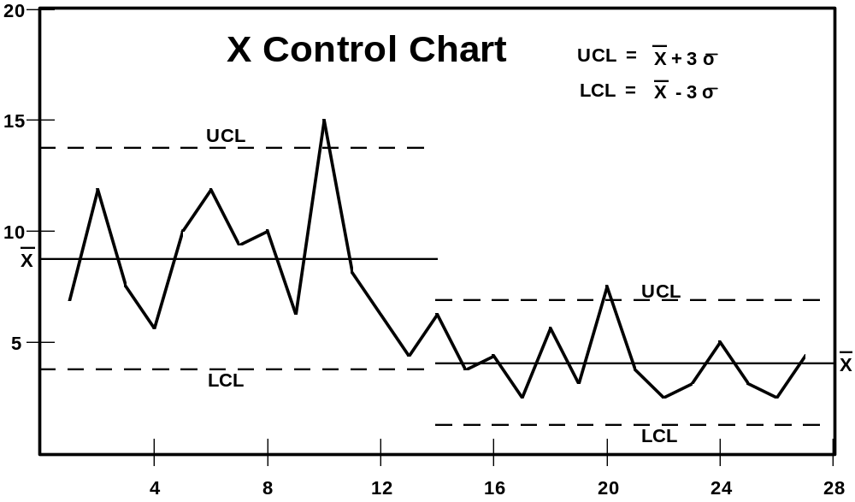
Statistical Quality Control
Notes:
Statistical Control Limits - taught by Dr. Walter Shewhart to Dr. Deming for Manufacturing control are now the foundation for the Quantitative Process Management KPA at level 4.
The idea is that an organization, department, or project can establish a base, set upper and lower statistical control limits, and then track progress and take needed corrective action to keep within those control limits. These concepts are just as applicable to software processes as they are to manufacturing processes. In both cases the processes must be defined, data collected, trend analysis conducted and corrective action taken.

Slide 39
Quality Management Concepts
Participative statistical process control.
Quality first.
Process management.
Senior management involvement.
Management is responsible for the system.
Continuous improvement.
Plan, do, check, act (PDCA).
Notes:
Again Dr. Shewhart’s basic process improvement concepts of Plan, Do, Check, Act. His principles

Slide 40
Development of the SPI Models
1979 Quality Management Maturity Grid published in “Quality Is Free” by Philip Crosby
1984 Software Engineering Institute established
1985 Process architecture and site study articles published in IBM Systems Journal
1986 Draft Maturity Questionnaire and Model
Maturity Questionnaire Mapped Against Model
1987 SEI First Report on the Maturity Model Is Published
SEI First Report on the Maturity Questionnaire
British Ministry of Defence Standard BS5750 is incorporated into ISO 9001-3 on the application of ISO 9000 quality standards to software development
1988 Maturity Questionnaire Version 0.3
1989 Maturity Questionnaire Version 0.51 Workshop
1990 Key Practice Input Drafted at CMM Workshop
Proposed baseline of CMM practices and paper 1991
CMM version 1.0 released for public comment and use
UK MOD study
1991 SPICE project launched
1992 CMM workshop - go over change requests
1993 CMM version 1.1 published
Bootstrap European process assessment methodology published under license of ESPRIT
1995 ISO 12207 information technology software life cycle processes
1996 SPICE version 2 published
1998 ISO/IEC 15504 published
1999 CMMI released for review
Notes:
Evolution of the CMM
ISPI Principals involved in
• Beta-testing of Maturity Questionnaire version .3
• Maturity Questionnaire

Slide 41
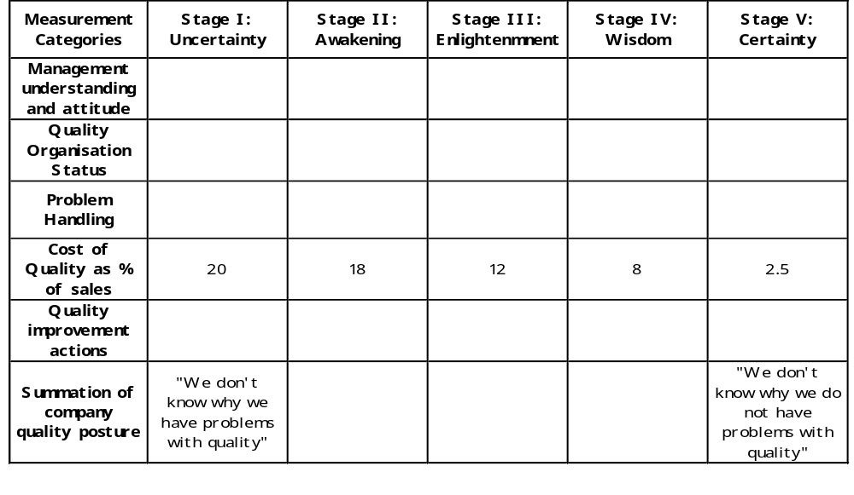
Quality Management Maturity Grid
From “Quality is Free” by Philip Crosby
Notes:
Quality Management Maturity

Slide 42
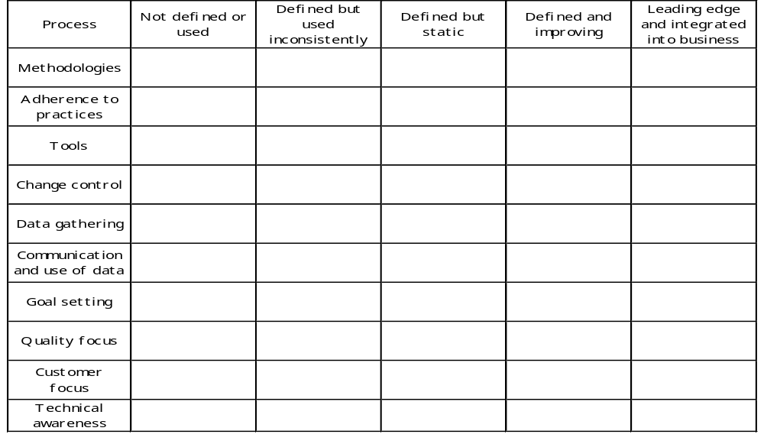
IBM Software “Process Grid”
From “A programming process study” by Ron Radice, et. al. in IBM Systems Journal Vol 24, No 2
Notes:
Process Maturity Grid created by Mr. Ron Radice as a tool in his Process Programming Study
Notice that the scale of low maturity to high maturity is reversed 5 - indicating a low maturity and 1- indicating a high maturity
The CMM today contains most of these concepts - The one exception is that the CMM does not place a lot of emphasis on Customer Focus.

Slide 43
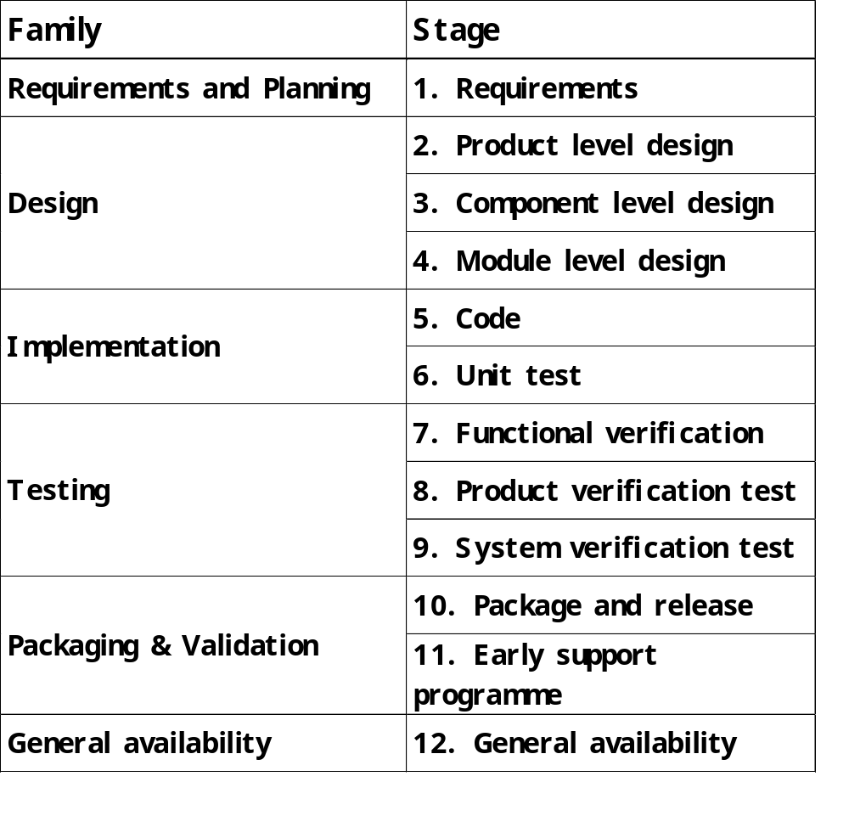
IBM Process Architecture Stages
Notes:
The IBM Process Architecture Stages depicted here form the basis of a Process Architecture referenced in the Process Definition KPA. It shows the various stages of requirements, design, code, and test with different levels of design and test per stage. Each project would tailor their project level process choosing, from the levels of each stage and choosing appropriate software life cycles and methods.
Example: A small project may have only two levels of design (High level design and low level design. A very large project may have four levels of testing (Module, Integration, Systems, Acceptance)

Slide 44
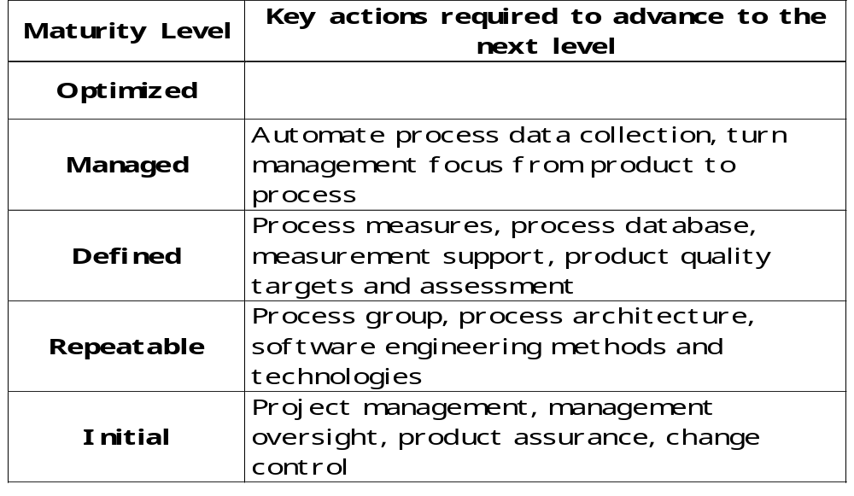
A Maturity Framework
Summarised from “Characterizing the Software Process: A Maturity Framework” by Watts Humphrey, SEI-87-TR-11
Notes:
First Maturity Framework slide that captured the Key Process Areas and which levels in the Maturity model they corresponded to. Captured in a Technical Report published by the SEI in 1987.
Notice that the Maturity level was mentioned and then the KPA that were required to be satisfied to advance the organization to the next maturity level.
For Level 2 KPAs Project Management was Planning and Tracking; Management Oversight was mentioned as its on KPA; Change Management was only mentioned as Change Control.
Level 3 KPAs concentrated on the Process Group, Process Architecture, and Software Engineering methods and technologies.

Slide 45
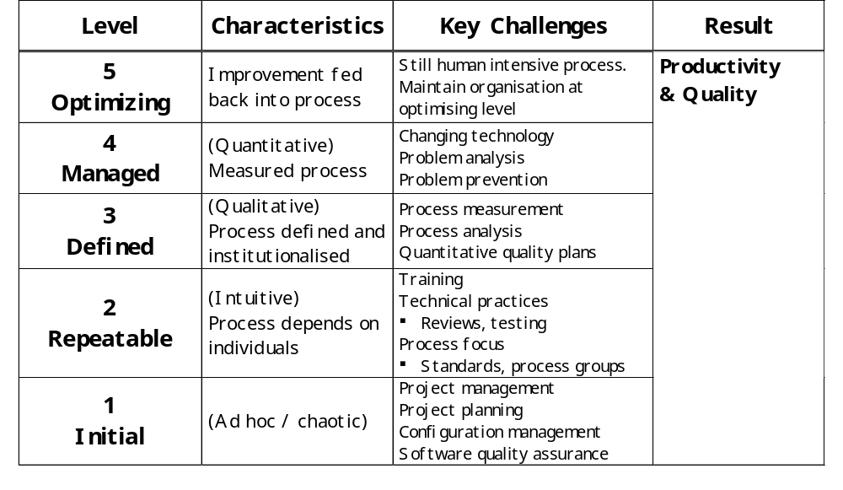
Maturity Level / Key Challenges
From SEI assessment training materials, 1989
Risk
Notes:
Maturity Model as it looked in 1989.
Level 2
Project Management now encompassed Project Tracking and Oversight.
Project Planning was mentioned on its own
Configuration Control had advanced to Configuration Management
Level 3
Training is mentioned as a Level 3 KPA
Reviews as well as testing is mentioned as technical practices

Slide 46
Introduction to SPI
Process Management Concepts

Slide 47
Process Management Premise
The quality of a software system is
governed by the quality of the process
used to develop and maintain it
or
Greater maturity leads to
better capability which contributes
to the production of better software
Notes:
Quality of the product is dependent on the quality of the process
Testing can no longer guarantee a quality product
Good process does not guarantee success, but if you fail, you should fail for the right reasons - such as the technology you were trying to achieve was just out of your grasp. Don’t fail because of:
• Poor planning
• Uncontrolled Requirements Change Requests
• Lack of a Commitment Process
• Poor quality procedures and support
• Lack of control of changes to the product baseline
These are all things or Management Practices that can be managed and controlled. You are in a position to guarantee not to fail in these areas

Slide 48
Characteristics of an Immature Process
Ad hoc; process improvised by practitioners and their management
Not rigorously followed or enforced
Highly dependent on current practitioners
Product quality difficult to predict
Likely cost and schedule problems due to ineffective estimating
Product functionality and quality often compromised in order to meet schedule
Use of new technology risky

Slide 49
Characteristics of a Mature Process
Defined and documented
  Understood
  Being used
  Living
Supported visibly by management
Clear definition and understanding of roles and responsibilities throughout project and organization
Well controlled - process fidelity is audited and enforced
Consistent with the way work actually gets done
Measured
Supported by technology
Notes:
Understood - effective training throughout the organization has been accomplished
Being Used - It is part of the developers daily lives - The documented processes reflect what is really happening
Living - As the processes are used ideas for improvement are submitted and find their way into the next revision of the processes - The processes are kept current with the changing needs of the projects and the organization
Management participate in Oversight reviews where process and quality are the main issues of concern - Management visibly shows its support for the process in the way they conduct their daily business
Everyone understands their roles and how they most effectively interact with each other
The processes are measured - their effectiveness is known - Problems in ‘downstream’ phases are predictable
The technology complements the process and enhances the capability of the software developers

Slide 50
Role of Maturity Model
Provides a guide for measuring an organization's software process capability
Sets goals and priorities for process improvement
Assists action planning effort
Outlines a method for applying process management and quality improvement concepts to software development and maintenance
Guides an organization toward software engineering excellence
Notes:
It provides a roadmap for continuous software process improvement
Helps the organization to set priorities for its process improvement efforts.
When I know where I am at, I can then decide where I want to go!!

Slide 51
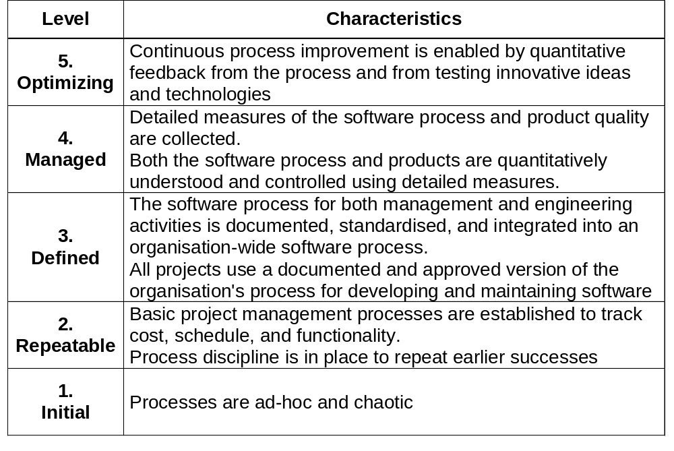
Capability Maturity Model Overview
Notes:
This represents the one slide version of the CMM
First focus on the process characteristics:
Initial:
Process is informal and ad hoc - Projects adopt the idea or process of the day
Repeatable:
Project Management practices are institutionalized
Defined:
Technical practices are integrated with management practices and institutionalized - ISM - Project management applied to the organizations standard software process
Managed:
Product and processes are qualitatively controlled (Bringing process in line with expected performance)
Optimizing:
Process improvement is institutionalized - Staff and managers are empowered to improve their own processes
-----------
One sentence descriptors of the KPAs at Level 2
Requirements Management
Establishing an agreement with the customer to maintain a common understanding of the customer’s requirements - Impact analysis of Requirements Change Requests is core to RM
Project Planning
Reasonable, feasible plans are established for each project
Project Tracking and Oversight
Keeping track of the progress of what you are developing and keeping management informed of how well the process is working a and the quality of the products being produced
Software Quality Assurance
Providing management
---------------
One sentence descriptors of the KPAs at Level 3
Process Focus
SEPG
Facilitators of process definitions at all levels
Change agents
Process Definition
Organizations’ Standard Software Process
Tailoring Guidelines
Process Database (Actuals to estimates from projects)
Software Process Library (Examples of good plans, procedures, etc.)
Software Lifecycles supported by the organization
Software Methods and tools supported by the organization
Software Product Engineering
Requirements Analysis; Design; Code; Module Test; Integration Test; Systems Test; Acceptance Test; Tools, Standards, Methods
Technical constraints on the defined software process
Peer Reviews
The application of in-process reviews such as Software Inspections to the Software Life Cycle Work Products (Req Specs, Design Specs, Code, Test Plans, Test Specs, Test Scenarios...)
Integrated Software Management
---------------
One sentence descriptors of the KPAs at Level 4
Software Quality Management
Defining product quality goals
Establishing plans to achieve those goals
Adjusting plans, procedures, and processes to support the achievement of the quality goals
Quantitative Process Management
-------------------
One sentence descriptors of the KPAs at Level 5
Defect Prevention
Paradigm shift from defect detection to defect prevention
Modify process so it becomes incrementally better over time
Causal analysis - using data not just for prediction

Slide 52
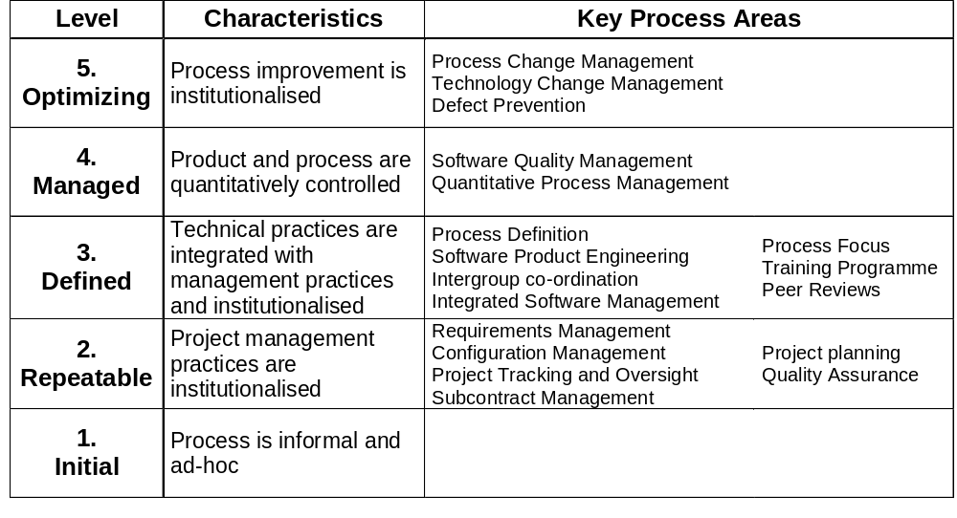
Capability Maturity Model Areas

Slide 53
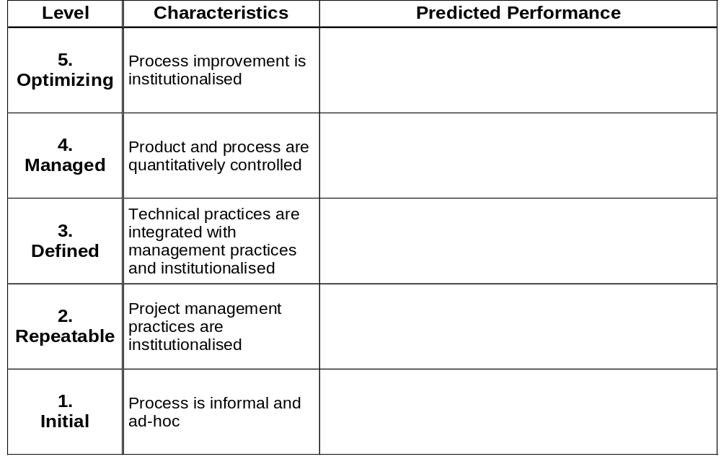
Process Capability Prediction
Target - z
Probability
Time/$/...
Probability
Target - y
Time/$/...
Probability
Target - x
Time/$/...
Probability
Target + a
Time/$/...
Probability
Target
Time/$/...
Notes:
Maturity helps the organization predict its ability to meet its goals
Initial:
Target dates (cost, schedule, quality) are often missed by wide variation
Repeatable:
Variability of actual results around the target decreases - Target is hit more often but target moves out due to realistic estimating and planning
Defined:
Variability decreases - Target hits increase - Target begins to move in - Less rework
Managed:
Variability continues to decrease - Targets results improve, development time becomes shorter, productivity and quality increase - Process is managed quantitatively
Optimizing:
Continuous process improvement - Defect prevention further helps to reduce rework shortening the development

Slide 54
Management Visibility
In
Out
In
Out
In
Out
In
Out
In
Out
Notes:
A way to describe Management's Visibility into the existing software process at the various maturity levels
Initial:
Process is an amorphous blob - Visibility into the process is difficult - We know that inputs go in, there is a lot of motion, and outputs come out
Repeatable:
The process can be viewed as a succession of black boxes that allow management visibility only at transition points (milestones or phase reviews) Can only make changes at the end of a phase
Defined:
Organization Standard Software Process - Management can now see what is happening within each software development phase allowing more effective risk management
Managed:
Defined software processes are instrumented and controlled quantitatively - Can make changes within a phase for single causes of variation
Optimizing:
Causal analysis - Defect prone processes are replaced or revised - Common causes of variation are detected and eliminated

Slide 55
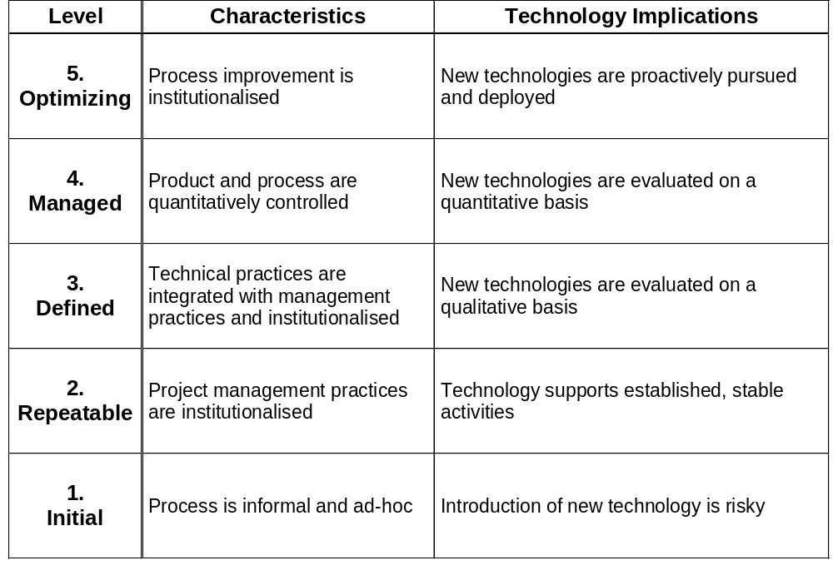
Technological Implications of Maturity
Notes:
Refer to the People, Process, and Technology triangle
Initial:
Introduction of technology is risky - Without having a defined process introducing new technology may only contribute more to the chaos instead of improving productivity as is claimed by most tool vendors. More errors may be introduced, time may be wasted, and the new tool or technology may become ‘shelfware’
Repeatable:
Technology can help automate the management practices that are in place
Defined:
The organization standard software process provides the requirements specification against which the tools and technology can be evaluated - This still refers to State-of-the-practice technology
Managed:
Quantitative Basis - Better understanding of processes and how tools can support the statistical process control
Optimizing:
State-of-the-ART technology is sought after based on the quantitative understanding of the software process - This technology is evaluated, trained, piloted and supported to institutionalization - This in turn may cause a change in the existing processes which may cause another search for the next technology breakthrough

Slide 56
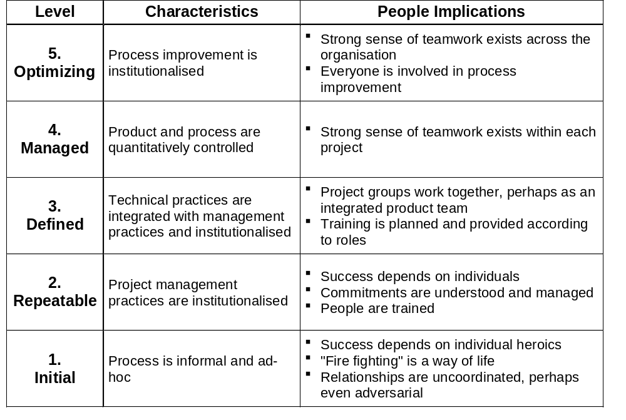
People Implications of Maturity
Notes:
Refer to the People, Process, and Technology Triangle
Initial:
Individual software developers are constantly under pressure and often find themselves ‘fighting fires’ or in crisis situations - This most often results in frustration and non-optimal performance
Repeatable:
While management practices are now institutionalized there is an over-reliance on the good, experienced people that understand the organization culture and specific application domain - If those individuals leave the organization the process maturity could be damaged
Defined:
Now there is an increased reliance on the defined process - software developers are starting to be viewed as assets

Slide 57
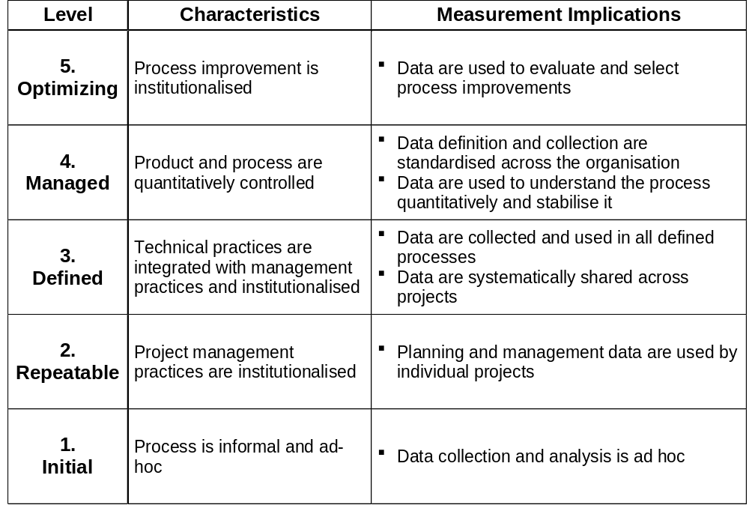
Measurement Implications of Maturity

Slide 58
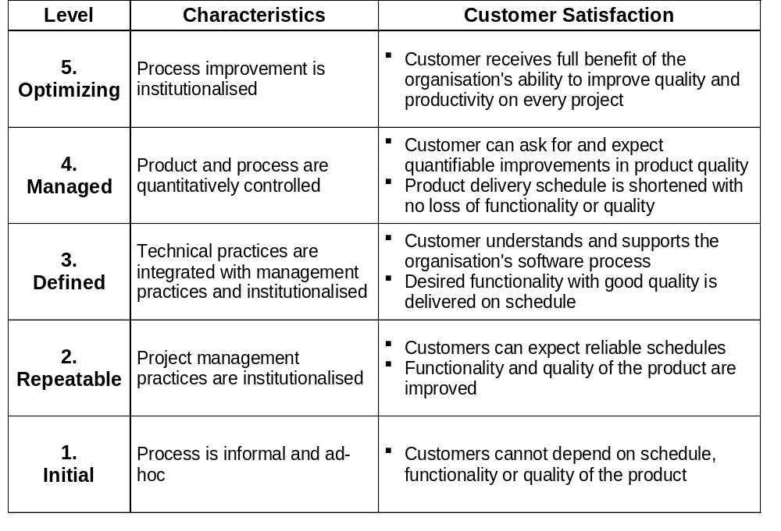
Customer Satisfaction Impacts of Maturity
Notes:
A comparison of customer satisfaction to the process maturity of an organization
Initial:
With the organization’s process being in a chaotic state, the customer cannot depend on the schedule, the functionality, or quality of the product. They count on the heroes of the company to produce something usable around the agreed upon date
Repeatable:
With the management practices institutionalized the customer can begin to depend of reliable schedules - In addition, the customer can expect to see increased functionality and quality
Defined:
The customer can now has visibility into the organization’s software process - This allows them to support this process to ensure that they receive the desired functionality, with the required quality according to the agreed upon schedule
Managed:
The customer can expect quantifiable improvements in the product quality - They should also see a shortened delivery schedule with no loss of quality or functionality
Optimizing:
The customer is now receiving the full benefit of the organization’s ability to improve its productivity and quality on each release as it continues to improve its process

Slide 59
Customer Satisfaction Impacts of Maturity
Notes:
A comparison of customer satisfaction to the process maturity of an organization
Initial:
With the organization’s process being in a chaotic state, the customer cannot depend on the schedule, the functionality, or quality of the product. They count on the heroes of the company to produce something usable around the agreed upon date
Repeatable:
With the management practices institutionalized the customer can begin to depend of reliable schedules - In addition, the customer can expect to see increased functionality and quality
Defined:
The customer can now has visibility into the organization’s software process - This allows them to support this process to ensure that they receive the desired functionality, with the required quality according to the agreed upon schedule
Managed:
The customer can expect quantifiable improvements in the product quality - They should also see a shortened delivery schedule with no loss of quality or functionality
Optimizing:
The customer is now receiving the full benefit of the organization’s ability to improve its productivity and quality on each release as it continues to improve its process

Slide 60
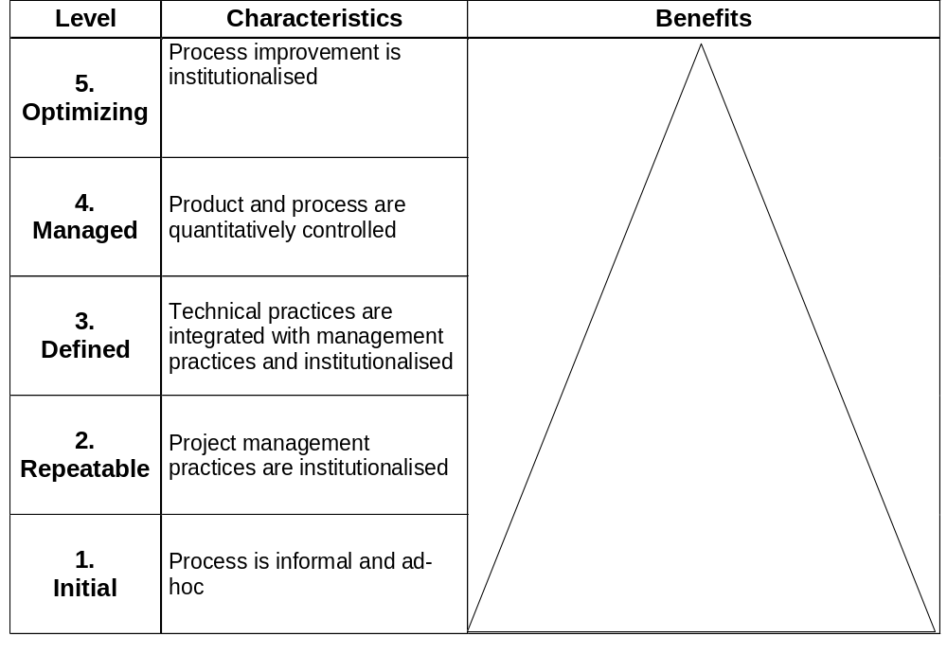
Customer Satisfaction Impacts of Maturity
Quality
Productivity
Customer Satisfaction
Risk
Notes:
This is a picture of the Process Management Premise
The quality of a software system is governed by the quality of the process used to develop and maintain it
There is a risk of doing business with organizations that are Level 1: You are counting on the heroes to repeat their super performance again and again
As the organization increases in process maturity quality and productivity go up and we expect to see an equivalent increase in customer satisfaction as well

Slide 61
ISO/IEC 15504 Structure
Process
Assessment
Compatible
Model
Competent
Assessor
Assessment
Process
Usable process,
people and
tools for the
assessment
Requirements
ensuring the
functional
requirements
are met
Assessment
Process
Requirements
Reference
Model

Slide 62
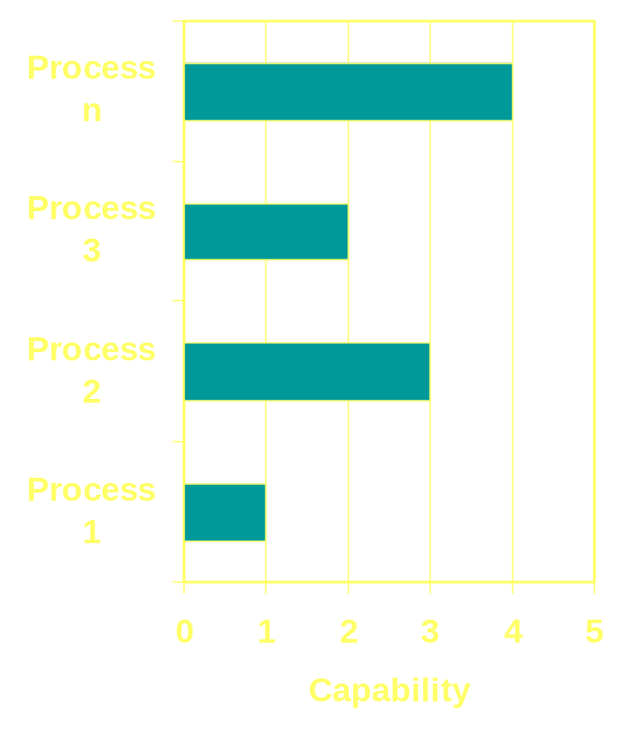
ISO/IEC 15504 Model Architecture - 1
Two dimensional reference model:
  Process dimension -
    Closely linked to ISO/IEC 12207 life cycle standard,
    Groups processes into groups;
  Capability dimension -
    Allows the capability of each individual process to be measure independently.

Slide 63
ISO/IEC 15504 Model Architecture - 2
Primary Processes
Supporting Processes
Acquisition
Documentation
Configuration Management
Supply
Quality Assurance
Verification
Development
Operation
Validation
Joint Review
Tailoring
Maintenance
Audit
Problem Resolution
Organisational Processes
Management
Infrastructure
Improvement
Training

Slide 64
Comparing the Approaches
Capability Maturity Model
  Allows to determine an overall level of an organization.
  Assists in prioritising improvement efforts.
  Details the activities required to achieve the defined goals while recognizing acceptable alternatives.
  May lead to believe that level 3 key process areas should not be started until all level 2 processes are in place.
ISO 15504
  Allows to recognize strengths in different areas from the beginning.
  Stresses the need that all areas should be worked on now.
  Recognizes the benefit of processes applied even if they are not documented, managed or controlled.
  May be lead to confusion in trying to prioritise limited resources.

Slide 65
Process Improvement Proverbs
Chinese Proverb: “If you don't know where you're going, any road will do”
Watts Humphrey: “If you don't know where you are, a map won't help”
Your organization's software process can be a strategic asset, if it is managed and matured
[quotes from "Managing the Software Process", Watts S. Humphrey]

Slide 66
Introduction to SPI
SPI Experiences

Slide 67
Process Maturity Profile
Source: Process Maturity Profile of the Software Community: 1999 Update, August 1999, SEMA.8.99
Organizations that conducted SEI software process assessments (SPAs) through August 1994 and provided results to the SEI:
• 1330 assessments
• 734 organizations
• 217 participating companies
• 244 reassessments
• 3390 projects
• 27.2% international sites

Slide 68
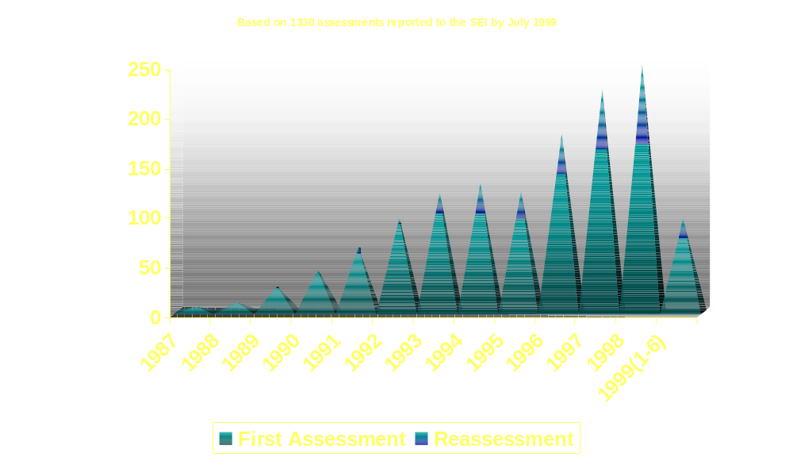
Number of Assessments per Year
Source: Process Maturity Profile of the Software Community: 1999 Update, August 1999, SEMA.8.99

Slide 69
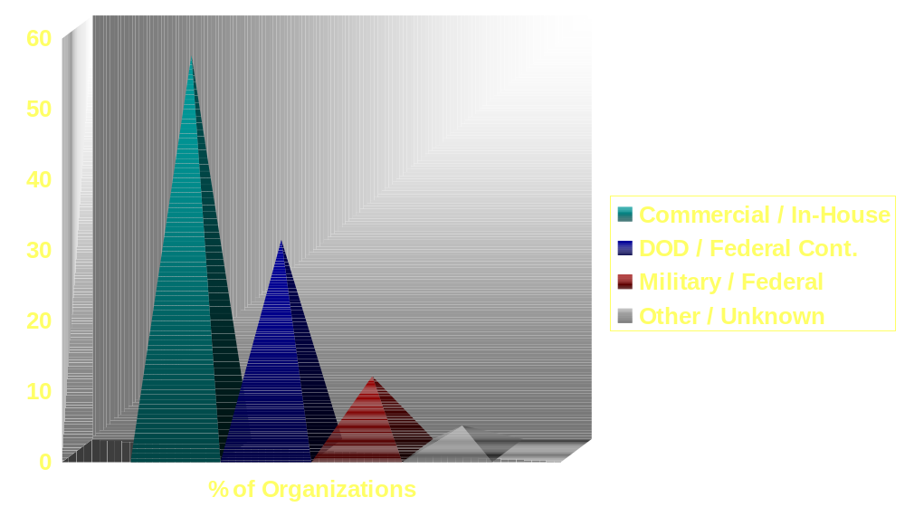
Participating Organization Types
Source: Process Maturity Profile of the Software Community: 1999 Update, August 1999, SEMA.8.99

Slide 70
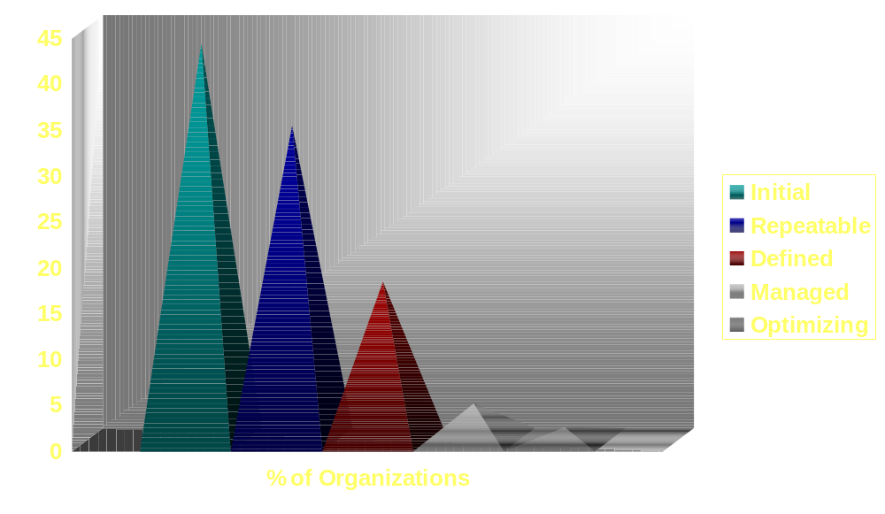
Organization Maturity Profile
Source: Process Maturity Profile of the Software Community: 1999 Update, August 1999, SEMA.8.99

Slide 71
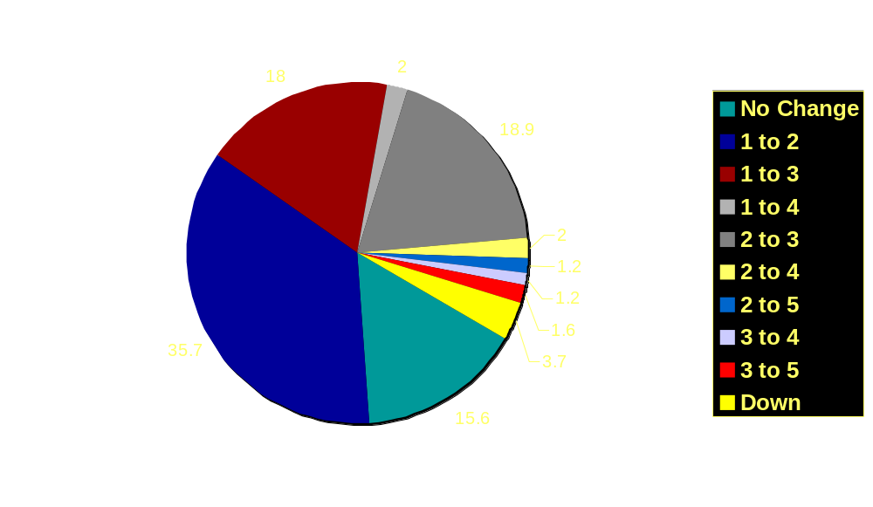
Reassessments -Change in Maturity Level
Source: Process Maturity Profile of the Software Community: 1999 Update, August 1999, SEMA.8.99
Based on 244 reassessments.

Slide 72
Maturity Summary Trends
Source: Process Maturity Profile of the Software Community: 1999 Update, August 1999, SEMA.8.99
Increasing proportion of commercial and in-house organizations
Nearly half the organizations reporting size have 100 or less software personnel
Overall community profile continues to shift towards higher maturity
SQA is the least frequently satisfied level 2 KPA among organizations assessed at level 1

Slide 73
Maturity Summary Trends – 2
Source: Process Maturity Profile of the Software Community: 1999 Update, August 1999, SEMA.8.99
Median time to move from maturity level 1 to 2 is 25.5 months for organizations that begun their CMM-based SPI effort in 1992 or later
Median time to move from maturity level 2 to 3 is 19 months for organizations that begun their CMM-based SPI effort in 1992 or later

Slide 74
ROI Data Collected
Source: CMU/SEI-94-TR-13
Cost
Productivity
Early defect detection
Schedule
Quality
Business value

Slide 75
Participating Organizations
Source: CMU/SEI-94-TR-13
Bull HN
GTE Government Systems
Hewlett Packard
Hughes Aircraft Co.
Loral Federal Systems
Lockheed Sanders
Motorola
Northrop
Schlumberger
Siemens Stromberg-Carlson
Texas Instruments
U. S. Air Force Tinker AFB Air Logistics Center
U. S. Navy Fleet Combat Direction Systems Support Activity

Slide 76
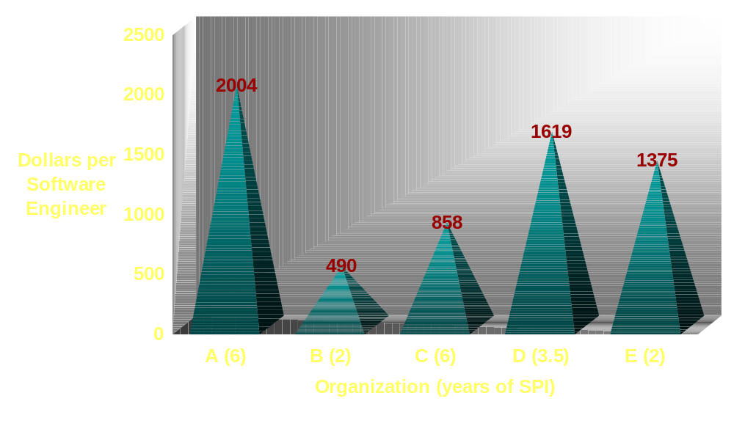
Yearly Expenditure on SPI
Source: CMU/SEI-94-TR-13

Slide 77
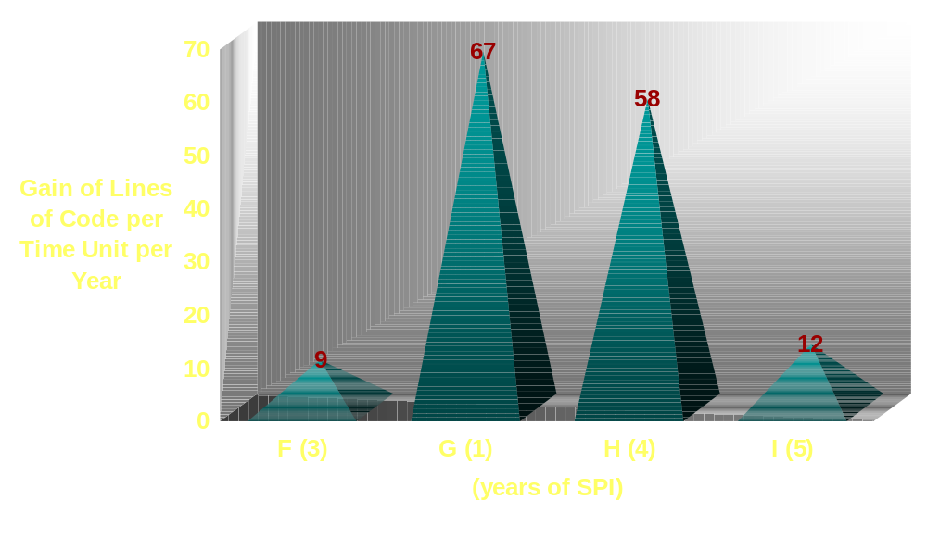
Productivity
Source: CMU/SEI-94-TR-13
Notes:
1.3
6.3
1.8
1.67

Slide 78
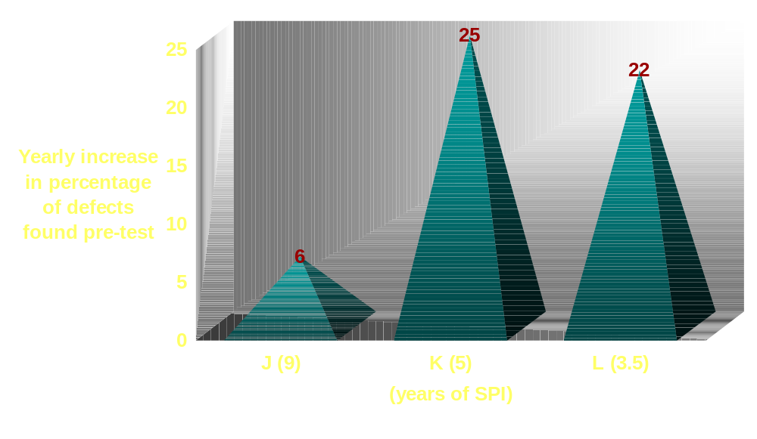
Early Defect Detection
Source: CMU/SEI-94-TR-13
Notes:
1.74
3.1
2.0

Slide 79
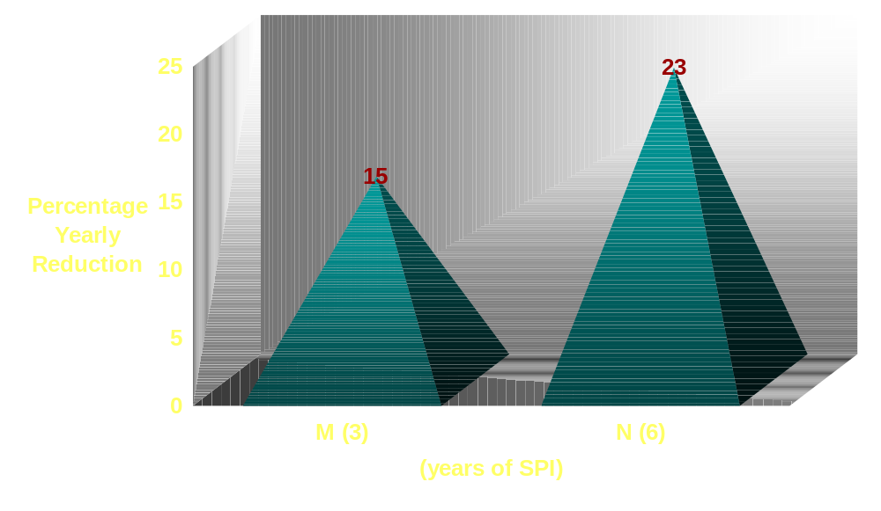
Time to Market
Source: CMU/SEI-94-TR-13
Notes:
.61
.21

Slide 80
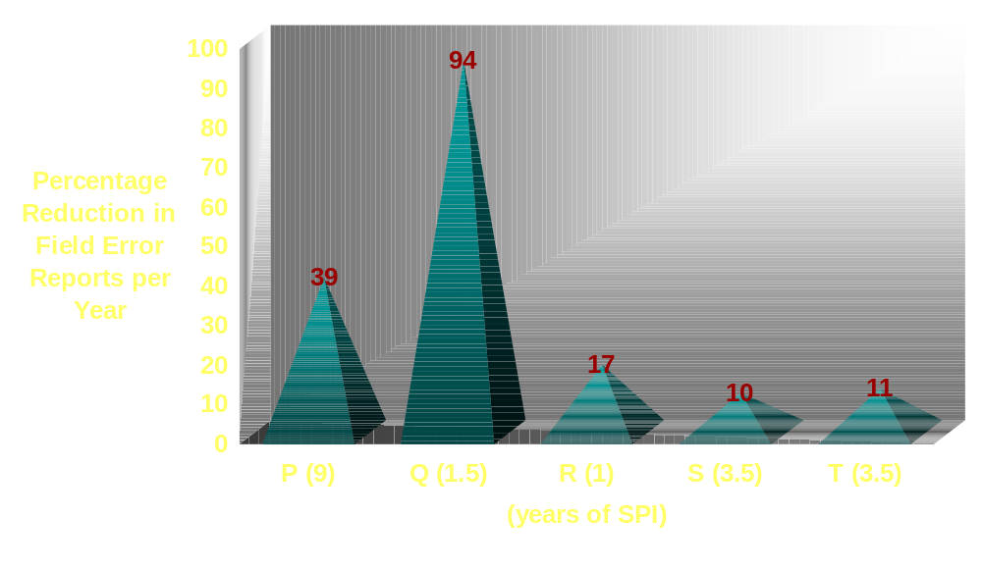
Quality
Source: CMU/SEI-94-TR-13
Notes:
.01
.015
.3
.7
.67

Slide 81
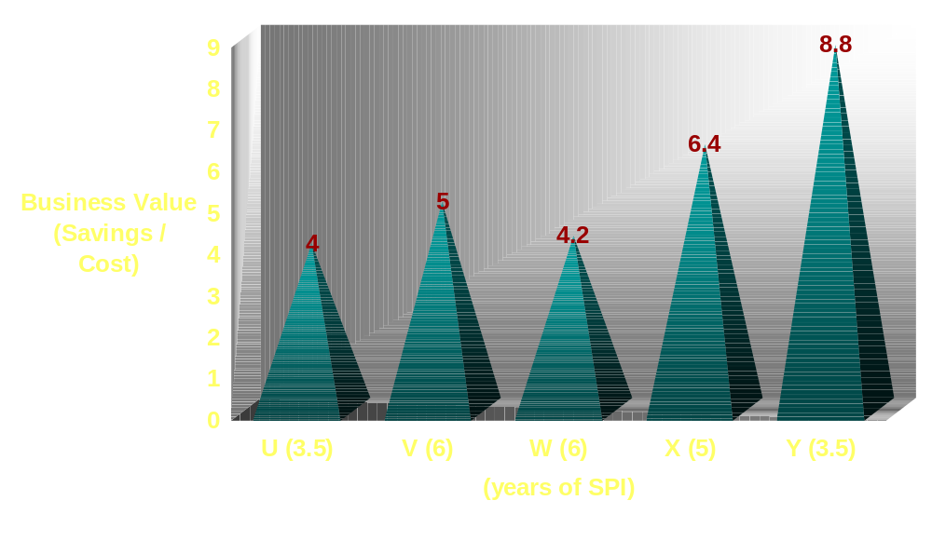
Business Value
Source: CMU/SEI-94-TR-13

Slide 82
Process Improvement Impact on Software Industry
Yearly European SEPG conference:
  1996: Just over 200 attendees
  1999: Nearly 500 attendees
        Data provided by the European Software Process Improvement (ESPI) Foundation
Software Process Improvement Network Societies (SPINS)
  25 in USA
  15 international

Slide 83
Introduction to SPI
Software Process Improvement
Infrastructure

Slide 84
Purpose of the SPI Organization
Coordinate the software process development and improvement activities across the Product Line
Ensure that the software processes developed within the organization are in line with the overall business goals and strategies of the Product Line
Ensure that software process development and improvement activities are planned and tracked

Slide 85
Sample Software Process Improvement
Infrastructure
Process Improvement Organization Structure
Development Organization Structure
Senior Management
Advisory Board
Senior Management
Middle Management
Non-
Project
Staff
SEPG
Steering Committee
Project Management
Process Liaisons
Project Members
Working
Group 1
Working
Group n
• • •
Notes:
For process improvement to be successful or to even have a chance of success it requires the support of all levels of management and the practitioners.
Sample SEPG Organizational Structure shows an infrastructure on the left that is composed of members from the organization represented by the right side of the diagram
Senior Management Advisory Board - Comes from Senior Management and staff
Steering Committee - Composed of Middle Managers. Middle Managers are in a difficult position. They receive pressure from above to meet or exceed schedules and budget limits, and they receive pressure from below to provide new workstations, tools, and methods. They sometimes appear to be the most resistant to to process improvement and the resulting changes that appear to threaten their existence. But they also own the software developers. It is for these reasons that it is critical to have them own the day-to-day management of the process improvement effort
Working Groups - The working groups are composed of software engineers who have the background and interest to analyze existing processes in a particular Focus Area and make recommendations for their revision and implementation on the projects. Normally working group members commit to a percentage of their time to the process improvement effort. This time should be protected by the middle management. The time scheduled for contributions to process improvement activities should be part of the WG members job description. Reviews, salary increases, and promotions should be linked to the WG members contributions to the process improvement effort as well as the regular job. WG Members normally contribute 20-50% of their time to process improvement. A WG member may be part of a working group for a year to a year and a half.
Process Liaisons - This is a task that requires at most 5% of an individuals time. The process liaison is a person on a project who is interested in process improvement enough to keep up with the status of the process improvement effort and who communicates periodically with the SEPG to pass on the status to his/her project. The process liaison may help prepare the project to receive the new processes.
While most organizations do not set up a Process Improvement Infrastructure exactly like the one shown above, most organizations do set up a structure that includes Senior Managers, Middle Managers, Project Leaders, and Practitioners.
The following list elaborate on the job tasks each of the groups representing the Process Improvement Infrastructure should be involved with
Senior Management Advisory Board
Provides top management credibility and support for change projects
Provides rationale as to how the process improvement changes fit into the overall culture and vision of the organization
Focuses on relating the change effort to the broader goals of the organization
Communicates why the change is needed to the total organization
Ensures that the necessary resources for the Working Groups and SEPG are available in a timely fashion
Steering Committee
Specifies technical/managerial activities to support the process improvement effort
Ensures the compatibility of the organization’s software policies and procedures with system policies and customer requirements
Establishes the Working Groups to address specific organizational process improvement needs
Establishes the percent of time working group members will participate
Conducts management oversight reviews on a periodic basis
Analyzes the software process data provided by the Working Groups and the SEPG
Makes risk management decisions and/or recommendations to the Senior Management Advisory Board
Supports the SEPG interaction with the projects
Working Groups
Develops the action plan for a specific Action Plan Focus Area
Guides the projects into adopting process improvement ideas on their projects
Develops software process definitions
Develops appropriate standards and procedures for software
Identifies, screens, and evaluates technologies
Suggests and/or develops training plans
Reports action plan progress to the Steering Committee
Shares the lessons learned on the Working Group with others on his/her project
Works with the SEPG to transfer the new technologies into the organization
SEPG
Facilitates the definition and improvement of the technical and managerial processes for developing and maintaining software
Conducts periodic reviews (at least quarterly) with the Senior Management Advisory Board
Conducts periodic reviews with the Steering Committee
Facilitates the activities of the Working Groups
Maintains a software process data base
Provides software process consultation on software process methods and practices
Facilitates the definition of software process metrics
Coordinates and/or conducts periodic software process audits
Shares good ideas with all projects throughout the organization
Communicates the process improvement progress to the organization on a regular basis
Process Liaisons
Practitioners on projects
Willing to serve as a process improvement advocate in a smaller way to support their project
Helps the SEPG to find the working policies, procedures, processes, methods, and standards
Assists the SEPG in introducing new processes into their project
Keeps up with advances in process improvement

Slide 86
Senior Management Advisory Board
Relates the change effort to the broader goals of the organization (business strategy)
Creates the environment to ensure process improvement becomes a part of the culture and vision of the organization
  Demonstrates regular and consistent visible support
    for specific change actions
    for continuous process improvement in general
Notes:
Senior Management needs to share its vision and business goals with the SEPG and the Working Groups to ensure that the process improvement effort supports those business goals.
Senior Management needs to state the importance of the process improvement effort in a visible fashion to let the organization know it is indeed as important as one of the most important projects
Senior Management needs to ensure that the necessary resources for the Working Groups and the SEPG are available in a timely manner (Training Courses, computers, consultants)

Slide 87
Senior Management Advisory Board - 2
Communicates why the change is needed to the total organization
  Approves/protects budget for the process improvement initiative
Ensures that the necessary resources are available in a timely fashion
Notes:
Senior Management needs to share its vision and business goals with the SEPG and the Working Groups to ensure that the process improvement effort supports those business goals.
Senior Management needs to state the importance of the process improvement effort in a visible fashion to let the organization know it is indeed as important as one of the most important projects
Senior Management needs to ensure that the necessary resources for the Working Groups and the SEPG are available in a timely manner (Training Courses, computers, consultants)

Slide 88
Senior Management Advisory Board
Proposed Membership
Senior managers in the organization:
  Product Line/Organization Manager (Chair)
  Key Line Managers
  Key Product Managers
  Quality Director
  Software Process Manager (also on Steering Committee)
Notes:
The Senior Management Advisory Board was added by ISPI in 1993.
Participation by the Senior Management team and particularly the Senior Manager is critical if any process improvement is to take place.
As Dr. Deming stated, it is management that owns the process and they must be willing to support the process improvement initiative or it will flounder and possibly die altogether.
These are just names that may not even fit the organization being addressed.
The boss may delegate responsibility for PI in the form of a delegated chair for the SMAB but this is strongly discouraged.
The point is the SMAB needs to be a group (individual for small organizations) that has the responsibility and authority to make and enforce strategic decisions.
We could be talking division or departments managers--whoever can achieve the purposes noted on the previous slide.

Slide 89
Steering Committee
Ensures that SPI activities are in line with the business goals as established by the SMAB
  Reviews the proposed budget for the improvement effort
  Makes recommendations to the SMAB regarding program direction, budget, and program risks
Notes:
Budget review -- includes resources for the implementation of the improved processes: training, equipment, software, etc.
“Necessary resources” -- basically getting the right people, when needed, as long as they are needed.
Middle Management support is necessary if the an organization expects to have top, qualified people working on the WGs and on the SEPG. The time allocated and spent on the WGs must be protected by the Middle Managers or the entire process improvement effort will be in danger.

Slide 90
Steering Committee - 2
Ensures that the necessary resources for the Working Groups and SEPG are available in a timely fashion
  Establishes the WGs for specific purposes
  Supports, where needed, negotiations for people’s time
Notes:
Budget review -- includes resources for the implementation of the improved processes: training, equipment, software, etc.
“Necessary resources” -- basically getting the right people, when needed, as long as they are needed.
Middle Management support is necessary if the an organization expects to have top, qualified people working on the WGs and on the SEPG. The time allocated and spent on the WGs must be protected by the Middle Managers or the entire process improvement effort will be in danger.

Slide 91
Steering Committee - 3
Conducts program oversight reviews on a periodic basis
  Ensures SPI activities progress in line with documented budgets and plans
  Performs or delegates review/approval of WG deliverables
Provides visible support for the SEPG and WGs

Slide 92
Steering Committee
Proposed Membership
  Middle and project managers:
  Functional managers
  Project managers
  Chief systems engineer (don’t limit perspective to software)
  SQA Manager
  SPM
Notes:
As with the SMAB, we need to identify the right people in the middle that we need to oversee/support the SPI effort and WG activities.
In most organizations, the point of greatest resistance is found in the middle management.
Middle managers constantly receive pressure from above to guide projects under their authority to completion on time, within budget, and with the promised functionality or above.
Middle managers receive constant pressure from below also as the software developers are constantly asking for new state-of-the-art software tools, and new computers, databases, languages, file servers, and work stations. Each request comes with a high price tag but with the promise that productivity may be increased by 10%, 15%, even up to 25%.
Many middle managers have climbed the corporate ladder by being good hardware engineers. Yet suddenly they find themselves managing projects where 80% of the project is software. They are being asked to make decisions for which most have had little or no training or experience.
One reason a PI program is important to Middle Managers is that it can give control back to them so they are in a position to make informed management decisions.

Slide 93
What Is an SEPG?
Focal group for action planning, process improvement, technology insertion, etc.
Channel for institutionalising knowledge of process methods, practices, and technology
Champion of change
Facilitator of improvement efforts at all levels
  Organization
  Project
  Individual
Notes:
The SEPG is the focal point for all efforts in the improvement plan.

Slide 94
What Does the SEPG Have to Know?
Senior management strategic direction
Organizational culture
Organizational structure
General knowledge of application domains
Knowledge of modern software engineering techniques and methods
Knowledge of software engineering standards (DoD, MOD, IEEE, ISO)
Knowledge of software support activities such as SQA and SCM
Managing Change
Team Building
Collaborative Consulting Skills
Technology Transition
Project Management
Metrics
Notes:
SEPG members must have a strong software engineering background, understand the software support functions such as SQA and SCM.
SEPG members need to understand the organizational structure and culture.
They must be respected by the mangers and software engineers alike
They must have high communication skills both in writing and verbally
They need to be people oriented and be willing to perform most of their work away from their desks, in the offices and labs of the software developers who need their support to understand just how the process improvement ideas fit in to their daily lives.
SEPG members should be always ready to provide “Handholding” support for the managers and practitioners on the various projects where the process ideas are being introduced.
While SEPG members must have the technical background to maintain credibility with the software developers, they must also be knowledgeable in the organizational development skills as well. Understanding and applying the right mix of technical know-how and behavioral psychology is what an SEPG member’s job is really all about!
The SEPG Group should strive to show by example how process improvement should be accomplished.

Slide 95
Software Engineering Process Group
Coordinate up, down, and across the organization
  Conducts periodic SMAB reviews (at least quarterly)
  Conducts periodic SC reviews (at least monthly)
  Facilitates the activities of the Working Groups (daily)
  Promotes technical awareness and education about SPI
Notes:
While each of these tasks are important ones for the SEPG members, it must be stressed that the job of the SEPG is to be the champion of the process improvement effort. The SEPG is expected to facilitate the process change - NOT Be Responsible for the process change!
SEPG members need to focus on finding the good practices that exist on projects and share those good practices with the rest of the organization
Facilitating WG activity -- ‘daily’ just means staying on top of what is going on
Promoting technical awareness is a continuous job for the SEPG--Process Liaisons are great vehicles for performing this function.

Slide 96
Software Engineering Process Group - 2
Manage/facilitate the SPI efforts
  Facilitates the definition/improvement of the technical and managerial processes, methods, techniques, and tools for developing and maintaining software
  Facilitates the definition and maintenance of organization policies and standards for software processes and products
  Oversees and facilitates piloting and implementation of improvements into the projects and across the organization
  Directs the definition of software process metrics; initiates the collection of data; and assists WGs in analysis and use
Notes:
The SEPG is the common thread for all of the Software Process Improvement Infrastructure components and they need to represent the needs of the software developers
PAL--Process Asset Library

Slide 97
Software Engineering Process Group - 3
Ensure the processes are "living"
  Maintains a dialogue with project personnel regarding the application and performance of development processes
    shares good ideas from other parts of the organization
    listens to issues/ideas from practitioner perspectives
  Initiates periodic re-assessments of the organization’s software engineering process
  Initiates practitioner-driven reviews of specific processes

Slide 98
Software Engineering Process Group - 4
Maintain a library of "software process assets"
  Oversees the software process database (PAL) for software product and process assets used across the organization
  Facilitates development and retention of tailoring guidelines for specific use of the assets in the PAL

Slide 99
SEPG
Proposed Membership
Software Process Manager (SEPG Leader)
Process champions
  Motivated and respected
  Knowledgeable
    technically capable
    process cognizant
  Team players
Associate members may be drawn from pilot projects and/or product segments
Associate members may represent function, product line, or other affected organizational entities
Notes:
An SEPG must have full time members. Watts Humphrey suggested that 1-3% of the software budget should be devoted to the SEPG. It is certain that one SEPG member is not enough. The SEPG may have part time members as well, but it should be recognized that less than 50% of a person’s time will not be very effective.

Slide 100
Software Process Manager
Coordinate all SPI activities in the organization
Link among SMAB, Steering Committee, and the SEPG
Link between the SPI initiative and the organization’s line, function, and project management

Slide 101
Working Groups
Develop the action plan for a specific focus area
Develop new or improved processes, procedures, guidelines, templates, etc.
  Based on a formally documented and approved plan
Identify, screens, and evaluates technologies based on the organization’s and project’s processes
Suggest and/or develop training plans
Support the piloting of those processes

Slide 102
Working Groups - 2
Evaluate pilot performance and revise the processes as necessary
Report process improvement progress to the Steering Committee
Share lessons learned on the Working Group with other Working Groups and project members
Support the institutionalisation of the tested and approved processes

Slide 103
WGs (generic)
Proposed Membership
WG Leader - (high effort)
Core Members - (high effort)
SEPG Representative - (moderate to high effort)
SQA Representative - (low to moderate effort)
Members - (low to moderate effort)
Consultants - (low effort)
Reviewers - (low effort)

Slide 104
Project Process Liaisons
Point-of-contact between the SPI organization and the project practitioners
  Keeps projects informed of SPI activities
  Provides input to SEPG/WGs regarding:
    good practices being performed
    strong candidates for WG involvement
  Serves as the process improvement advocate for the project
Notes:
The concept of Process Liaisons was also added by ISPI in 1993
The concept of Process Liaisons is very simple. Usually on a project, there is at least one person who is quality minded or process improvement minded. While this person is not ready to change his/her career and join the SEPG, they are interested in process improvement and are willing to spend about 5% of their time keeping up with the process improvement progress and sharing process improvement news with their other project members.
Process Liaisons can help transition the process improvement ideas into their projects

Slide 105
Project Process Liaisons - 2
Provide information and feedback to the SEPG and WGs regarding:
  Issues impacting development performance
    where the problems are
    what the degree of pain is
  Use of new processes in the project

Slide 106
SQA - Agent for Process Improvement
Focusing on improving the process can improve product quality and developer productivity
A proactive SQA approach provides
  Feedback to projects
  Input on process efficiency and effectiveness to the SEPG
  Visibility into the process and resulting product quality to management
If the SEPG is the keeper of the process, SQA is the defender of the process

Slide 107
SQA Role in Process Improvement
Management
Management
Provides visibility into the effectiveness and efficiency of the processes being used and the resulting product quality
SQA
SEPG
Projects
SEPG
Projects
Provides feedback to the individual projects on the efficiency and effectiveness of the processes that they are following so they can be improved at the project level
Provides feedback to the SEPG on the organizational processes they have facilitated in developing so they can be improved at the organizational level
Notes:
If the Software Engineering Process Group is viewed as the keeper of the process
Then Software Quality Assurance can be viewed as the defender of the process
SQA provides visibility into the software process for management
SQA can collect the process data and feed it back to the projects in a proactive manner to help them improve their processes
SQA can let the SEPG know how efficient and effect the processes used by the software developers are

Slide 108
Goals of SPI Program
Move from development processes owned by individuals through a project-based system to an organizationally defined and supported development process that
  Achieves CMM goals
  Achieves/retains any needed standards compliance such as ISO 9001 and/or ISO 9000-3 certification
  Leverages off the good practices currently in place
Provide unified direction to ensure coherent, consistent, value-added conformance to all development standards (CMM, ISO/industry, local quality directives...)

Slide 109
Initial Actions Required of
Senior Management
<date> Announce your commitment for SPI throughout the organization (then take advantage of every opportunity to reiterate that commitment)
<date> Establish the SMAB
<date> Arrange for and participate in SMAB kick-off meeting
<date> Participate in Steering Committee kick-off meeting
<date> Establish the SQA support role for the SPI initiative (based on the Steering Committee proposal)
Notes:
Senior Management may include product line management.
Depending on the size of the organization and the scope of the PI initiative, what is presented on this and following slides may be considerably telescoped--make it real for the organization.
SPI requires the active support of all levels of mgt if it will succeed and survive.

Slide 110
Initial Actions Required of SMAB
<date> Hold kick-off meeting
<date> Brief organization management regarding the goals/purpose of the SPI program
<date> Establish Steering Committee
<date> Arrange for and participate in Steering Committee kick-off meeting
<date> Call for designation of representatives to SEPG
<date> Develop SPI strategy related to business goals (in partnership with the Steering Committee & SEPG)
<date> Review, approve, and allocate budget to support initial SPI action plan

Slide 111
Initial Actions Required of
Steering Committee
<date> Hold kick-off meeting
<date> Negotiate training resources for SEPG
<date> Call for designation of project Process Liaisons
<date> Review, negotiate, and approve the Action Plan
<date> Present SPI approach to Senior Management and obtain commitment to it
<date> Define and propose initial SPI budget requirements
<date> Negotiate training resources for WG(s)
<date> Review and approve SEPG operating procedures
<date> With SQA, develop, then present SQA proposal to senior management
Notes:
The Steering Committee may be involved in developing parts of the action plan.

Slide 112
Initial Actions for Software Process Manager
<date> Negotiate focus area priorities for first year
<date> Define means for disseminating SPI information
<date> Arrange for SEPG kick-off meeting
<date> Determine and propose training for SEPG
<date> Define a profile for project Process Liaisons
<date> Ensure project Process Liaisons are designated
<date> Provide expectations to project Process Liaisons
<date> Arrange for training of SEPG and WG(s)
<date> Arrange WG kick-off meeting(s)

Slide 113
Initial Actions Required of SEPG
<date> Hold kick-off meeting
<date> Develop action plan for SEPG and SPI activities
<date> Develop top-level SPI outline
<date> Propose candidates for WGs
<date> Define expected achievements of the WGs
<date> Complete initial SEPG training
<date> Determine initial training requirements for WG(s)
<date> Review WG action plan(s)
<date> Combine SEPG, SPI, and WG action plans into a single SPI action plan for the organization/product line

Slide 115
Software Process Improvement
Capability Maturity Model
Overview

Slide 116
CMM Structure
[from SEI-93-TR-25, "Capability Maturity Model for Software"]r
Maturity Levels
indicate
Process
capability
contain
Key Process Areas
achieve
Goals
organized by
Common Features
address
Implementation/
Institutionalisation
contain
Key Practices
describe
Infrastructure /
Activities
Notes:
The CMM Structure can be presented as a tree structure
Maturity Level - There are 5 maturity levels composed of two or more key process areas that an organization should focus on to improve its process
Process Capability - How well an organization implements these KPAs indicates its process capability
To achieve a maturity level, the key process areas at the level must be satisfied
To satisfy a KPA, each of the goals must be satisfied
The goals summarize the key practices at a high level
The key practices highlight the activities that contribute the most to the institutionalization and and implementation of the KPA
Institutionalization - Entails building an infrastructure and corporate culture that supports the methods, practices, and procedures so that they may endure
Implementation - Entails what is to be done and who is responsible (What procedures need to be written and who will write and review them)
KEY - The CMM does not describe all of the KPAs in detail nor is it all inclusive

Slide 117
Maturity Levels
[from SEI-93-TR-24, "Capability Maturity Model for Software, Version 1.1"]
Optimizing
(5)
Well-defined evolutionary plateau, a layer in the foundation for subsequent process improvement activities.
Continuously
Improving
process
Managed
(4)
Predictable
process
Defined
(3)
Standard,
Consistent
process
Repeatable
(2)
Disciplined
process
Initial
(1)
Notes:
Well defined evolutionary plateau
A foundation for subsequent process improvement activities - Foundation is the key word here. Examples
When you build a house, the foundation needs to be poured first before the walls can be built
If you build a brick wall, the bottom bricks need to be laid first
Skipping Maturity Levels
Frequently the topic of skipping maturity levels comes up. Why not start working on Level 3 KPAs before you reach Level 2. Organizations can use processes described at a higher maturity level but these processes cannot reach their full potential until the proper foundation is laid. Processes without the proper foundation fail at the very point they are needed most - under stress - and they provide no basis themselves for future improvement.
The diagram shows a cascading ‘Salmon Ladder’.
1->2 - Organization moves to a managed, controlled, disciplined process
2->3 - Organization has a standard, consistent process that is understood, being used, and living (it is kept up-to-date)
3->4 - The results of using the process is becoming predictable
4->5 - The preventative nature of the process leads to continuous process improvement
“And when you reach the top of the ladder you DIE!!” (a bit of humor)

Slide 118
Process Capability
Key process
areas
Process
maturity
constitute
enable
indicates
Process
capability
The range of expected
results that can be
achieved by following
a software process.
predicts
Process
performance
Notes:
Process Capability
The range of results expected from following a software process
The software process capability of an organization provides one way of predicting the expected results for the next software project the organization undertakes that is similar in application
Process Performance
The actual results achieved from following a process
Process Maturity
An organization's ability to consistently follow and improve its process

Slide 119
Process Capability
from SEI-93-TR-25, "Capability Maturity Model for Software"
Key Process
Area Goals
Commitment
to perform
Verifying
implementation
Ability to
perform
Measurement
and Analysis
Activities
performed
Notes:
The key practices in each key process area are organized by a set of common features
The common features are attributes that indicate whether the implementation and institutionalization of a key process area is effective, repeatable, and lasting
The common features also group and order the key practices into a sequence helpful to individuals, groups, or organizations that are using them
The practices in the common feature Activities Performed describe what must be implemented to establish a process capability
The other practices taken together, form the basis by which an organization can institutionalize the practices described in the Activities Performed common feature

Slide 120
Essence of the Common Features
from SEI-93-TR-25, "Capability Maturity Model for Software"
Commitment to perform.
  Describes the actions the organization must take to ensure that the process is established and will endure.
  Involves establishing organizational policies and designating responsible managers or groups.
    The project follows a written organizational policy for...
    A manager is designated to be responsible for...
Notes:
This slide plus the next four slides provides an overview of what information is normally contained in each Common Feature section of every KPA in the CMM

Slide 121
Essence of the Common Features - 2
from SEI-93-TR-25, "Capability Maturity Model for Software"
Ability to perform.
  Describes the preconditions that must exist in the project or organization to implement the software process competently.
  Involves resources, organizational structures, and training:
    Responsibilities of groups/managers to support/perform the activities are defined;
    Resources (e.g., personnel, tools) and funding exist to support the KPA activities;
    Training is provided to personnel responsible for performing KPA activities;
    Orientation is provided to personnel affected by KPA activities.

Slide 122
Essence of the Common Features - 3
from SEI-93-TR-25, "Capability Maturity Model for Software"
Activities performed.
  Describes the roles and procedures necessary to implement a key process area.
  Involves establishing plans and procedures, performing the work, tracking it, and taking corrective actions as necessary:
    Work products are defined (e.g., plans, documents, software risks, estimates);
    Activities are planned according to documented procedures;
    Typical contents of procedures are defined;
    Typical participants in activities are identified;
    Typical reviewers of work products are identified.

Slide 123
Essence of the Common Features - 4
from SEI-93-TR-25, "Capability Maturity Model for Software"
Measurement and analysis.
  Describes the need to measure the process and analyse the measurements.
  Includes examples of the measurements that could be taken to determine the status and effectiveness of the activities performed:
    Measurements are made (and used) to determine the status and quality of work products and activities.

Slide 124
Essence of the Common Features - 5
from SEI-93-TR-25, "Capability Maturity Model for Software"
Verifying implementation.
  Describes the steps to ensure that the activities are performed in compliance with the process that has been established.
  Encompasses reviews and audits by management and software quality assurance:
    Activities are reviewed periodically with senior management;
    Activities are reviewed periodically and at milestones with project managers;
    SQA (SCM or independent group for some KPA) reviews, audits, and reports activities to management.

Slide 125
Process Institutionalisation Criteria
For all processes and subprocesses that exist to govern an organization's software development:
  Is this process documented?
  Does it have a written policy requiring its use?
  Does it have visible management support at all levels?
  Does it have visible practitioner support across the organization?
Notes:
These criteria come from the Common Features of
Commitment to Perform
Ability to Perform
Measurement and Analysis
Verifying Implementation
These questions should be kept in mind as the assessment team reviews process documentation and gathers data from the interviews

Slide 126
CMM Level 1
The Initial Level

Slide 127
Characteristics of the Initial Level (1)
  Process capability is unpredictable.
  The software process is constantly changed or modified as the work progresses.
  Actual processes used are not documented or maintained - processes belong to individuals.
  Schedules, budgets, functionality, and product quality are generally unpredictable.
  Performance can only be predicted by individual rather than organizational capability.
  However, level 1 organizations do produce software!
  Strong reliance on, and reward of, heroic individual efforts and gurus.
Notes:
One of the main points on this slide is the third item that states that the processes of a Level 1 organization belong to the individual.
Individuals that serve as the process voice of a project or department influence those around him/her. Sometimes the process is documented and sometimes it is not. But the personality behind its introduction is responsible for keeping it alive.
The reason that Level 1 companies succeed and sometimes serve as the world leaders is because of those heroes who will work long into the night, sacrificing almost anything in order to deliver a product that is acceptable to the customer.

Slide 128
Initial Level (1) Key Process Areas
There are no key process areas at level 1.

Slide 129
Process Institutionalisation Criteria - 2
  Are there sufficient resources available to support its use?
  Is it scheduled into all applicable projects or activities?
  Is it supported by required training?
  Is it measured in some way?
  Is it verified to occur via reviews and audits?
Notes:
These criteria come from the Common Features of
Commitment to Perform
Ability to Perform
Measurement and Analysis
Verifying Implementation
These questions should be kept in mind as the assessment team reviews process documentation and gathers data from the interviews

Slide 130
CMM Level 2
The Repeatable Level

Slide 131
Characteristics of the Repeatable Level
  Software project schedules and budgets are under control.
  Planning and managing new projects is based on experience with similar projects.
  Realistic commitments are made and met as compared to level 1.
  Project plans are made and followed - progress is tracked and appropriate status is visible to management.
  Technical practices may not be formally defined and vary from project to project.
  The software process belongs to the project software manager.
Notes:
At the Repeatable Level the software process now belongs to the project software manager - All of the projects have the basic management practices under control - Thus software development plans, software quality plans and requirements are managed in a consistent predictable manner.
The technical practices may vary from project to project but they are usually followed by the project members.

Slide 132
Repeatable Level (2) Key Process Areas
from SEI-93-TR-25, "Key Practices of the Capability Maturity Model, Version 1.1"
Requirements Management.
Software Project Planning.
Software Project Tracking and Oversight.
Software Subcontract Management.
Software Quality Assurance.
Software Configuration Management.
Notes:
There are six (6) KPAs at Level 2
They are listed above in an order that is different from the way they appear in the CMM
ISPI believes that this order allows one to discuss the flow - the interrelationships between the KPAs in an easier manner
Documented requirements are the basis for Project Planning
The estimates and plans from Project Planning are used to track progress against in Project Tracking and Oversight
Software Quality Assurance ensures that project processes are being followed as documented
Software Configuration Management assists the projects to control the work product that comes out of their processes
Subcontract Management is the application of the other five Management practices to the subcontractor
Each Maturity Level has a central KPA that the others gather around - At Level 2 that KPA is Software Project Planning

Slide 133
CMM Level 2
Requirements Management

Slide 134
Requirements Management
Purpose
from SEI-93-TR-25, "Key Practices of the Capability Maturity Model, Version 1.1"
The purpose of Requirements Management is to establish a common understanding between the customer and the software project of the customer's requirements that will be addressed by the software project.

Slide 135
Requirements Management
Goals
from SEI-93-TR-25, "Key Practices of the Capability Maturity Model, Version 1.1"
The goals of Requirements Management are:
  System requirements allocated to software are controlled to establish a baseline for software engineering and management use;
  Software plans, products, and activities are kept consistent with the system requirements allocated to software.
Notes:
Systems requirements allocated to software:
Customer Requirements
Systems Engineering
Allocated to H/W
Allocated to S/W
Requirements Analysis
Requirements Specification
Design
Code
After the requirements
analysis, it may be
decided that a requirement
that was thought to
be implementable in
software must be
implemented in hardware
The Req Mgmt process
should reflect these possible
steps

Slide 136
Requirements Management
from SEI-93-TR-25, "Key Practices of the Capability Maturity Model, Version 1.1"
Requirements Management involves establishing and maintaining an agreement with the customer on the requirements for the software project
Written agreements are maintained with each project's customers as to the technical and non-technical requirements for the software throughout the software lifecycle.
The project team reviews the requirements for: feasibility, clarity, consistency and testability, and resolves any problems found, with the customer, before they are accepted
Notes:
The major point of emphasis for Requirements Management is the impact analysis on the Requirements Change Requests
The operative phrasing here is Requirements Change Requests. It is not necessarily good business to agree with every customer request for a change just because you believe you cannot say no to the customer.
The requirements change request must be analyzed for its impact to
The existing system
To the schedule
To the resources required
To related product lines
To the overall quality of the product
Making a change might make more sense in a later release
It is the organization’s responsibility to conduct this impact analysis and inform the customer of the results. The customer may not want to jeopardize a release for a risky feature that there is little demand for in the first place

Slide 137
Requirements Management - 2
from SEI-93-TR-25, "Key Practices of the Capability Maturity Model, Version 1.1"
The requirements are used as the basis for estimating, planning, performing, and tracking project activities
Changes to the requirements are: analysed for their potential impact to the existing plans and work products, reviewed, incorporated as appropriate, and controlled.
Notes:
The major point of emphasis for Requirements Management is the impact analysis on the Requirements Change Requests
The operative phrasing here is Requirements Change Requests. It is not necessarily good business to agree with every customer request for a change just because you believe you cannot say no to the customer.
The requirements change request must be analyzed for its impact to
The existing system
To the schedule
To the resources required
To related product lines
To the overall quality of the product
Making a change might make more sense in a later release
It is the organization’s responsibility to conduct this impact analysis and inform the customer of the results. The customer may not want to jeopardize a release for a risky feature that there is little demand for in the first place

Slide 138
CMM Level 2
Software Project Planning

Slide 139
Software Project Planning
Purpose
from SEI-93-TR-25, "Key Practices of the Capability Maturity Model, Version 1.1"
The purpose of Software Project Planning is to establish reasonable plans for performing the software engineering and for managing the software project.

Slide 140
Software Project Planning
Goals
from SEI-93-TR-25, "Key Practices of the Capability Maturity Model, Version 1.1"
Software estimates are documented for use in planning and tracking the software project;
Software project activities and commitments are planned and documented;
Affected groups and individuals agree to their commitments related to the software project.

Slide 141
Project Planning
from SEI-93-TR-25, "Key Practices of the Capability Maturity Model, Version 1.1"
For each software project a plan is developed, according to a documented procedure, that covers the software activities and commitments.
The requirements allocated to software form the basis for the software development plan.
A software lifecycle with defined stages is used as a framework for the plan.
Notes:
Every software project is expected to develop a software plan
It is developed according to a documented procedure and is based on historical data

Slide 142
Project Planning - 2
from SEI-93-TR-25, "Key Practices of the Capability Maturity Model, Version 1.1"
The plan includes documented size, cost, schedule, and resource estimates developed according to a written procedure and based on historical data.
Estimates for critical computer resources are documented, reviewed, and agreed to.
All affected groups and individuals understand the estimates and plans and commit to support them.
Notes:
All affected groups provide input to the estimates and commitment to support them. This is a weakness in over 75% of all of the companies developing software who have been assessed so far.
The Software Development Plan either contains or references a Software Quality Plan, and a Software Configuration Management Plan
Senior management understands the impact to the organization of the commitment that is going to be made to the customer and is prepared to support the organization to fulfill that commitment
Risk management is performed at a basic level
Management loses creditability if they ask for impossible schedules on a regular basis

Slide 143
Project Planning - 3
Senior management reviews the estimates and plans before external commitments are made.
Software risks associated with the cost, resources, schedule, and technical aspects of the project are identified, evaluated, and contingencies documented.
Planning and estimation data are collected for use in planning subsequent projects and for input in Management Oversight review meetings.

Slide 144
CMM Level 2
Software Project Tracking and Oversight

Slide 145
Software Project Tracking and Oversight - Purpose
from SEI-93-TR-25, "Key Practices of the Capability Maturity Model, Version 1.1"
The purpose of Software Project Tracking and Oversight is to provide adequate visibility into actual progress so that management can take effective actions when the software project’s performance deviates significantly from the software plans.

Slide 146
Software Project Tracking and Oversight - Goals
from SEI-93-TR-25, "Key Practices of the Capability Maturity Model, Version 1.1"
Actual results and performances are tracked against the software plans.
Corrective actions are taken and managed to closure when actual results and performance deviate significantly from the software plans.
Changes to software commitments are agreed to by the affected groups and individuals.

Slide 147
Project Tracking and Oversight
from SEI-93-TR-25, "Key Practices of the Capability Maturity Model, Version 1.1"
The software development plan is used as the basis for tracking the software activities and communicating status.
Actual results of all software projects are tracked routinely against their planned estimates.
Corrective actions are taken when actual results deviate significantly from estimates.
Changes to planned commitments are understood and agreed to by all affected groups and individuals.
Notes:
Watts Story
A project was writing software for a new magnetic tape drive
The software team only had one prototype to test with
They started missing critical milestones that threatened the entire schedule
Did not ask management for help
Turned out there was a warehouse of machines available
Actuals to estimates are tracked and corrective action is taken when the actual results are significantly different from the estimates.
Any changes to commitments that need to be made as a result of the suggested corrective action is once more negotiated with all affected groups

Slide 148
Project Tracking and Oversight - 2
from SEI-93-TR-25, "Key Practices of the Capability Maturity Model, Version 1.1"
Technical, cost, resource, and schedule risks are tracked.
Estimates and actuals are captured in an organization-wide historical database.
The Project team conducts periodic reviews of progress against plans:
  Technical, cost, staffing, and schedule performance;
  Use of critical computer resources;
  Dependencies between groups.
Notes:
Four types of reviews are mentioned explicitly in the CMM - Two of them are presented on this slide
Project review - The team meets normally on a weekly basis to discuss the progress of the project against the software development plan
Milestone reviews - Formal reviews occur at significant milestones. These are normally conducted with the customer, end user, and other interested parties. It is as much for providing a level of comfort for the customer as it is for discussing issues and reexamining the commitment

Slide 149
Project Tracking and Oversight - 3
from SEI-93-TR-25, "Key Practices of the Capability Maturity Model, Version 1.1"
Formal reviews occur at selected milestones.
  Addresses commitments, plans, and status of the software activities.
  Conducted with the customer, end user, and affected groups within the organization.
Notes:
Senior Management Oversight reviews are the third type of review
Watts often asked for this type of review to occur at least once every three months.
It was to ensure that Senior Management was aware of what was happening in the software projects and how the processes being used were helping to produce the desired product quality
The fourth type of review mentioned in the CMM is the Peer Review which will be discussed with the Level 3 KPAs

Slide 150
Project Tracking and Oversight - 4
from SEI-93-TR-25, "Key Practices of the Capability Maturity Model, Version 1.1"
Senior Management reviews are conducted.
  Technical, cost, staffing, and schedule performance.
  Conflicts and issues not resolvable at lower levels.
  Effectiveness of process being followed on each project.
  Degree to which quality plan is being followed and the resulting product quality.

Slide 151
CMM Level 2
Software Quality Assurance

Slide 152
Software Quality Assurance
Purpose
from SEI-93-TR-25, "Key Practices of the Capability Maturity Model, Version 1.1"
The purpose of Software Quality Assurance is to provide management with appropriate visibility into the process being used by the software project and of the products being built.

Slide 153
Software Quality Assurance
Goals
from SEI-93-TR-25, "Key Practices of the Capability Maturity Model, Version 1.1"
Software quality assurance activities are planned.
Adherence of software products and activities to the applicable standards, procedures, and requirements is verified objectively.
Affected groups and individuals are informed of software quality assurance activities and results.
Non-compliance issues that cannot be resolved within the software project are addressed by senior management.

Slide 154
Software Quality Assurance
from SEI-93-TR-25, "Key Practices of the Capability Maturity Model, Version 1.1"
SQA function is in place on all projects - an SQA plan exists for each project.
SQA participates in the preparation of the project’s plans, standards, and procedures.
SQA activities are planned and budgeted for each project.
Compliance of the software product and processes with applicable standards, procedures, and requirements is confirmed independently.
Notes:
All of the points on this slide are worth emphasizing.
Special emphasis might be placed on the first statement - The SQA function is in place on all projects - The project’s SQA plan should clearly indicate what the quality functions are, who is responsible for executing them, and where in the software lifecycle they should take place
Loosely translated, this slide is stating that SQA should report any noncompliance issues to the lowest possible level and only go up the management chain if no acceptable response is made

Slide 155
Software Quality Assurance - 2
from SEI-93-TR-25, "Key Practices of the Capability Maturity Model, Version 1.1"
SQA detected deviations are documented and tracked to closure, according to a documented procedure.
  Problems are handled at a level as close as possible to the source of the issue.
  An escalation procedure allows management visibility into unresolved issues, including senior management when appropriate.
Notes:
All of the points on this slide are worth emphasizing.
Special emphasis might be placed on the first statement - The SQA function is in place on all projects - The project’s SQA plan should clearly indicate what the quality functions are, who is responsible for executing them, and where in the software lifecycle they should take place
Loosely translated, this slide is stating that SQA should report any noncompliance issues to the lowest possible level and only go up the management chain if no acceptable response is made

Slide 156
SQA Role in Process Improvement
Management
Management
SQA
SEPG
Projects
SEPG
Projects
Notes:
If the Software Engineering Process Group is viewed as the keeper of the process
Then Software Quality Assurance can be viewed as the defender of the process
SQA provides visibility into the software process for management
SQA can collect the process data and feed it back to the projects in a proactive manner to help them improve their processes
SQA can let the SEPG know how efficient and effect the processes used by the software developers are

Slide 157
CMM Level 2
Software Configuration Management

Slide 158
Software Configuration Management
Purpose
from SEI-93-TR-25, "Key Practices of the Capability Maturity Model, Version 1.1"
The purpose of Software Configuration Management is to establish and maintain the integrity of the products of the software project throughout the project’s software lifecycle.

Slide 159
Software Configuration Management
Goals
from SEI-93-TR-25, "Key Practices of the Capability Maturity Model, Version 1.1"
Software configuration management activities are planned.
Selected software work products are identified, controlled, and available.
Changes to identified software work products are controlled.
Affected groups and individuals are informed of the status and content of software baselines.

Slide 160
Software Configuration Management
from SEI-93-TR-25, "Key Practices of the Capability Maturity Model, Version 1.1"
The software work products to be placed under configuration management are identified (e.g. plans, standards, procedures, requirements, designs, code, tests, test procedures, tools).
A plan for controlling changes to, and releases of, these items is defined and used.
A library exists for maintaining and creating the projects’ software baselines
A Software Configuration Control Board exists to manage the project’s software baselines and approve releases.
Notes:
Software Configuration Management - Major components
Identification
Change Control
Status Accounting
Auditing the configuration
Software Configuration Control Board
Software Baseline Library
Change History
Release Procedures

Slide 161
Software Configuration Management - 2
from SEI-93-TR-25, "Key Practices of the Capability Maturity Model, Version 1.1"
Changes are documented, reviewed, and approved, and historical information is maintained.
Status reports on a given baseline and changes made to it are readily available.
Change requests and trouble reports are tracked for all configuration items.
Baseline audits are conducted.

Slide 162
CMM Level 2
Software Subcontract Management

Slide 163
Software Subcontract Management
Purpose
from SEI-93-TR-25, "Key Practices of the Capability Maturity Model, Version 1.1"
The purpose of Software Subcontract Management is to select qualified subcontractors and manage them effectively.

Slide 164
Software Subcontract Management
Goals
from SEI-93-TR-25, "Key Practices of the Capability Maturity Model, Version 1.1"
The prime contractor selects qualified software subcontractors.
The prime contractor and the software contractor agree to their commitments to each other.
The prime contractor and the software subcontractor maintain ongoing communications.
The prime contractor tracks the software subcontractor’s actual results and performance against its commitments.
Notes:
The goals emphasize that subcontracting implies a relationship between the Contractor and the Subcontractor.
This relationship demands that the contractor and the subcontractor make commitments to each other, maintain ongoing communication, and the subcontractor’s performance is tracked against the plan

Slide 165
Software Subcontract Management
from SEI-93-TR-25, "Key Practices of the Capability Maturity Model, Version 1.1"
As prime contractor, the organization/project:
  Defines and uses evaluation criteria for selecting subcontractors based on ability to perform the work.
  Derives the statement-of-work for the subcontractor from the project’s requirements as well as the standards and processes to be followed.
  Reviews and approves the subcontractor’s software development plan.
  Reviews the subcontractor’s progress periodically and at major milestones.

Slide 166
Software Subcontract Management - 2
from SEI-93-TR-25, "Key Practices of the Capability Maturity Model, Version 1.1"
  Provides the subcontractor with feedback on his/her performance.
  Conducts acceptance testing as part of the delivery of the subcontractor’s software products.
  Coordinates the prime and subcontractor’s quality assurance and configuration management activities.

Slide 167
Level 2 KPA Relationships
Compatible SCM
Activities
Software
Project Tracking
& Oversight
Software
Configuration
Management
Compatible
Tracking/
Oversight
Activities
Baselines
Replan
What to Track
Baselines
Status
Baselines
Reports
Requirements
Management
Software
Project
Planning
Build Product
Process
Product
What to
Build
What
To Do
Compatible
Reqmts
Mgmt
Activities
Changes
Cause
Replan
Subcontractor's
Plans
Audits of
Plans
Process
Audit
QA Plans
Audit
Software
Subcontract
Management
Compatible
SQA Activities
Software Quality
Assurance

Slide 168
CMM Level 3
The Defined Level

Slide 169
Characteristics of the Defined Level
  Software processes now belong to the organization.
  All projects use the organization’s standard software process or a tailored version.
  A formal focus for process improvement exists.
  Both technical and management practices are documented, used, and living.
  Lessons learned and project artefacts are collected for study and re-use.
  All participants in the software process have the necessary knowledge and skills to perform their roles.
  Good communication.
Notes:
The point to emphasize here is the first one - that the software process now belongs to the organization and that all projects use a tailored version of this process

Slide 170
Defined Level (3) Key Process Areas
Organization Process Focus.
Organization Process Definition.
Software Product Engineering.
Integrated Software Management.
Peer Reviews.
Intergroup Coordination.
Training Program.
Notes:
There are seven (7) KPAs at Level 3
The central KPA is Process Definition - all of the other KPAs depend on this one to be established throughout the organization

Slide 171
CMM Level 3
Organizational Process Focus

Slide 172
Organization Process Focus
Purpose
from SEI-93-TR-25, "Key Practices of the Capability Maturity Model, Version 1.1"
The purpose of Organization Process Focus is to establish the organizational responsibility for software process activities that improve the organization's overall software process capability.

Slide 173
Organization Process Focus
Goals
from SEI-93-TR-25, "Key Practices of the Capability Maturity Model, Version 1.1"
Software process development and improvement activities are coordinated across the organization.
The strengths and weaknesses of the software process used are identified relative to a process standard.
Organization-level process development and improvement activities are planned.

Slide 174
Organization Process Focus
from SEI-93-TR-25, "Key Practices of the Capability Maturity Model, Version 1.1"
A group is established to focus on process definition and to facilitate improvement activities across the organization.
The software process is assessed periodically, and changes are implemented to address the findings.
The organization has a process definition and improvement plan.
Process data is collected at the organization level.
New technology is evaluated against the organization’s and project’s process definitions before it is applied.
Notes:
The real message here is one that Watts presented to us seven years ago - The process is not going to improve by itself!!
An organization needs a permanent process focus to help facilitate and coordinate the process improvement program for the entire organization.
It also need a infrastructure in place that will help guide and nurture the process improvement effort (SEE next slide)

Slide 175
CMM Level 3
Organizational Process Definition

Slide 176
Organization Process Definition
Purpose
from SEI-93-TR-25, "Key Practices of the Capability Maturity Model, Version 1.1"
The purpose of Organization Process Definition is to develop and maintain a usable set of software process assets that improve process performance across the projects and provide a basis for cumulative, long-term benefits to the organization.
Notes:
The Process Definition KPA represents much more than a Software Development Lifecycle that many organizations are familiar with. It includes Technical practice descriptions, Software Process Architectures, Software Process Elements such as a Requirements Specification template, Process Databases, Software Process Library, Tailoring Guidelines. All of these will be discussed in more detail in this section of KPA Overview Interrelationships

Slide 177
Organization Process Definition
Goals
from SEI-93-TR-25, "Key Practices of the Capability Maturity Model, Version 1.1"
A standard process for the organization is developed and maintained.
Information related to the use of the organization’s standard software process by the software projects is collected, reviewed, and made available.

Slide 178
Organization Process Definition
from SEI-93-TR-25, "Key Practices of the Capability Maturity Model, Version 1.1"
The organization has a documented, standard software process including a software process architecture and software process elements:
  Software estimating element;
  Software design element.
Descriptions of software lifecycles that are approved for use by the projects are documented.

Slide 179
Organization Process Definition - 2
from SEI-93-TR-25, "Key Practices of the Capability Maturity Model, Version 1.1"
The process includes tailoring guidelines for projects to derive their project-level process definitions.
The process definition is reviewed, maintained under configuration management, and updated regularly.

Slide 180
Organization Process Definition - 3
The organization’s software process database is established:
  Estimates of size, effort, and cost;
  Quality measurements;
  Productivity data;
  Peer review coverage and efficiency;
  Test coverage and efficiency;
  Number and severity of defects found in the software requirements and code.

Slide 181
Organization Process Definition - 4
from SEI-93-TR-25, "Key Practices of the Capability Maturity Model, Version 1.1"
A library of previously developed process specifications is maintained including:
  Project’s defined software processes
  Projects’ standards and procedures
  Projects’ development plans
  Projects’ measurement plans
  Projects’ process training materials
State-of-the-practice tools and methods are incorporated into the organization’s standard software process as appropriate

Slide 182
Organization’s Software Process Assets
from SEI-93-TR-25, "Key Practices of the Capability Maturity Model, Version 1.1"
Software
Process
Database
Software
Lifecycles
Organization's Standard
Software Process
Software Process
Architecture
Software
Process
related
Library
Tailoring
Guidelines
Software Process
Elements

Slide 183
Planning a Level 3 Project
from SEI-93-TR-25, "Key Practices of the Capability Maturity Model, Version 1.1"
Project’s
Software
Development
Plan
Organization's
Software
Process
Assets
Project’s
Defined
Software
Process
When a new project is started, the organization’s standard software process is tailored according to the guidelines to produce a project specific defined software process.
The project’s defined software process then becomes the basis for developing and implementing the project’s software development plan.
Notes:
Frequently in response to the question “Would you please describe your software development process?” we hear a response indicating that the project’s software development plan contains the process the project is going to follow.
The diagram above shows the relationship between the Organization’s Standard Software Process, the Project’s Defined Software Process, and the Project’s Software Development Plan
The Organization’s Standard Software Process + the Process Assets including the Tailoring Guidelines + an approved Software Lifecycle are used in conjunction with the Process Database to create the Project’s Defined Software Process. The Software Development Plan is then developed around that Project level process.

Slide 184
CMM Level 3
Software Product Engineering

Slide 185
Software Product Engineering
Purpose
from SEI-93-TR-25, "Key Practices of the Capability Maturity Model, Version 1.1"
The purpose of Software Product Engineering is to consistently perform a well-defined engineering process that integrates all the software engineering activities to produce correct, consistent software products effectively and efficiently.
Notes:
Software Product Engineering may also be referred to as the Software Life-cycle Functions

Slide 186
Software Product Engineering
Goals
from SEI-93-TR-25, "Key Practices of the Capability Maturity Model, Version 1.1"
The software engineering tasks are defined, integrated, and consistently performed to produce the software;
Software work products are kept consistent with each other.

Slide 187
Software Product Engineering
from SEI-93-TR-25, "Key Practices of the Capability Maturity Model, Version 1.1"
Appropriate tools and methods are used to build and maintain software and placed under configuration management.
Software requirements are identified, analysed, refined, and documented, and verified.
A software architecture and corresponding software designs are developed to implement the requirements.
Code is developed to implement the architecture and designs.

Slide 188
Software Product Engineering - 2
from SEI-93-TR-25, "Key Practices of the Capability Maturity Model, Version 1.1"
Test activities are performed to verify the design and validate that the implementation meets the requirements:
  Module, integration, systems, and acceptance testing.
Peer reviews are conducted on all work products before they are considered complete:
  Requirements specification;
  Design;
  Code;
  Test plans, test cases, test specifications.
Data on defects identified in reviews and testing are collected and analysed.
Notes:
Peer Reviews are mentioned here because they are often thought of as a technical practice.
Because of their importance, they are described in their own KPA

Slide 189
Software Product Engineering - 3
from SEI-93-TR-25, "Key Practices of the Capability Maturity Model, Version 1.1"
Product documentation is reviewed and approved by the customers and maintainers:
  Preliminary versions are available for engineering and customer/end user use;
  Final versions are verified against the baselined software;
  Final documentation is reviewed and approved by customers and/or end users.
Notes:
This is one of the few places where the importance of Product documentation is mentioned.

Slide 190
Software Product Engineering - 4
from SEI-93-TR-25, "Key Practices of the Capability Maturity Model, Version 1.1"
Consistency of software work products I maintained:
  Documentation on all work products is readily available;
  Software requirements, design, code, and test cases are traced to the source from which they were derived;
  Changes to the software work products, plans, process descriptions, and activities are proposed, analysed and incorporated as appropriate.
Notes:
This really refers to the ability to trace forward and backward from Requirements to Systems Tests and the assurance that when a document in the chain changes all related documents that must change are updated in a timely fashion

Slide 191
CMM Level 3
Integrated Software Management

Slide 192
Integrated Software Management
Purpose
from SEI-93-TR-25, "Key Practices of the Capability Maturity Model, Version 1.1"
The purpose of Integrated Software Management is to integrate the software engineering and management activities into a coherent, defined software process that is tailored from the organization's standard software process and related process assets.

Slide 193
Integrated Software Management
Goals
from SEI-93-TR-25, "Key Practices of the Capability Maturity Model, Version 1.1"
The project’s defined software process is a tailored version of the organization’s standard software process;
The project is planned and managed according to the project’s defined software process.

Slide 194
Integrated Software Management
from SEI-93-TR-25, "Key Practices of the Capability Maturity Model, Version 1.1"
Each software project has a defined software process that is a tailored version of the organization’s standard software process.
Each software project is planned and managed according to the project’s defined software process.
The organization’s software process database is used on each project for planning and estimating.
Each project’s risks are identified, assessed, documented, and managed according to a documented procedure.
Notes:
The application of Project Planning and Tracking practices to the Organization’s Standard Software Process and Process Assets.

Slide 195
CMM Level 3
Peer Reviews

Slide 196
Peer Reviews
Purpose
from SEI-93-TR-25, "Key Practices of the Capability Maturity Model, Version 1.1"
The purpose of Peer Reviews is to remove defects from the software work products early and efficiently. An important corollary effect is to develop a better understanding of the software work products and of defects that might be prevented.
Notes:
The earlier problems are found, the cheaper the cost to fix them
Peer Reviews may also be thought of as “Human Based Testing” - the only way to test a Requirements Specification
It has been shown and documented that if a project develops and successfully executes Module Tests, Integration Tests, Systems Tests, and Acceptance Tests, approximately 65% of all of the errors will be eliminated before the product is shipped to the field
If Peer Reviews (Software Inspections) are applied to the various Life-Cycle Products such as Requirements Specifications, Designs, Code, Data, Test Plans, Test Specifications, and Documentation, up to 95% of all of the errors can be eliminated before the product is shipped to the field

Slide 197
Peer Reviews
Goals
from SEI-93-TR-25, "Key Practices of the Capability Maturity Model, Version 1.1"
The goals of Peer Reviews are:
  Peer review activities are planned;
  Defects in the software work products are identified and removed.

Slide 198
Peer Reviews
from SEI-93-TR-25, "Key Practices of the Capability Maturity Model, Version 1.1"
Peer reviews are used widely throughout the organization to verify that work products are complete:
  Plans, schedules, process definitions, process artefacts.
Peer reviews to be done for each project are planned and scheduled.

Slide 199
Peer Reviews - 2
Peer reviews are performed according to a documented procedure.
All review participants receive required training.
The results of peer reviews are recorded in an organizational database.
Actions identified in the review findings are documented and tracked until they are resolved.

Slide 200
CMM Level 3
Intergroup Coordination

Slide 201
Intergroup Coordination
Purpose
from SEI-93-TR-25, "Key Practices of the Capability Maturity Model, Version 1.1"
The purpose of Intergroup Coordination is to establish a means for the software engineering group to participate actively with the other engineering groups so the project is better able to satisfy the customer's needs effectively and efficiently.

Slide 202
Intergroup Coordination
Goals
from SEI-93-TR-25, "Key Practices of the Capability Maturity Model, Version 1.1"
The customer’s requirements are agreed to by all affected groups.
The commitments between the engineering groups are agreed to by the affected groups.
The engineering groups identify, track, and resolve intergroup issues.

Slide 203
Intergroup Coordination
from SEI-93-TR-25, "Key Practices of the Capability Maturity Model, Version 1.1"
All groups responsible for a software project (or the system, if this software is part of a larger hardware/software system) coordinate their activities according to a documented and mutually accepted plan.
Regular communication among all affected project groups is used to resolve conflicts, clarify issues, and monitor progress.
Critical inter-group dependencies are identified, negotiated, and tracked
Products produced as inputs to other project groups are reviewed by the receiving group.
Notes:
Level 2
RM
AC.1 Review requirements allocated
to software
PP
AC.1 Participation on Proposal team
Level 3
IC
AC.1 Participate in estimating
Systems Requirements
Level 2
PP
AC.3 Commitments
AC.6
PT SDP available
AC.1 Changes to commitments
AC.4 gets communicated
Level 3
IC
AC.3 Documented plan for
communicating IC
commitments
Dependencies, documented,
negotiated, and tracked
Informal Formal

Slide 204
CMM Level 3
Training Program

Slide 205
Training Program
Purpose
from SEI-93-TR-25, "Key Practices of the Capability Maturity Model, Version 1.1"
The purpose of the Training Program is to develop the skills and knowledge of individuals so they can perform their roles effectively and efficiently.

Slide 206
Training Program
Goals
from SEI-93-TR-25, "Key Practices of the Capability Maturity Model, Version 1.1"
Training activities are planned.
Training for developing the skills and knowledge needed to perform software management and technical roles is provided.
Individuals in the software engineering group and software-related groups receive the training necessary to perform their roles.

Slide 207
Training Program
from SEI-93-TR-25, "Key Practices of the Capability Maturity Model, Version 1.1"
The organization has a training plan.
  Identifies what needs to be taught, to whom, by when, and budgets the required resources.
Each project has a training plan.
  Identifies the training needs of the project.
  Used as input to the organization training plan.
Training is performed in accordance with the plans.
Records of training are maintained.
Training courses are developed and maintained according to organization standards.
Notes:
Career development is a part of the training program
Example of becoming a manager without receiving any prior training

Slide 208
Level 3 KPA Relationships
Evaluations
& Reports
Evaluations
SW Product
Engineering
Integrated SW
Management
Peer Reviews
Subset of
Spe
Techniques
State of Practice
SW Engrg
Methods
Process
Assets
Esp.
Orgn Std
Sw Process
Lessons
Learned & Other
Process
Assets
Feedback
On Orgn
Process
Process for
Peer Reviews
Evaluations
Technical
Practices
Organization
Process Definition
Resources to
Facilitate
Effort
Organization Process Focus
Evaluations
What Needs
To Be
Trained
People Trained
To Do Their Part
Formal
Relationships
Required to
Succeed
Status of
Implementation
Efforts
Intergroup
Coordination
Training Program
SQA

Slide 209
CMM Level 4
The Managed Level

Slide 210
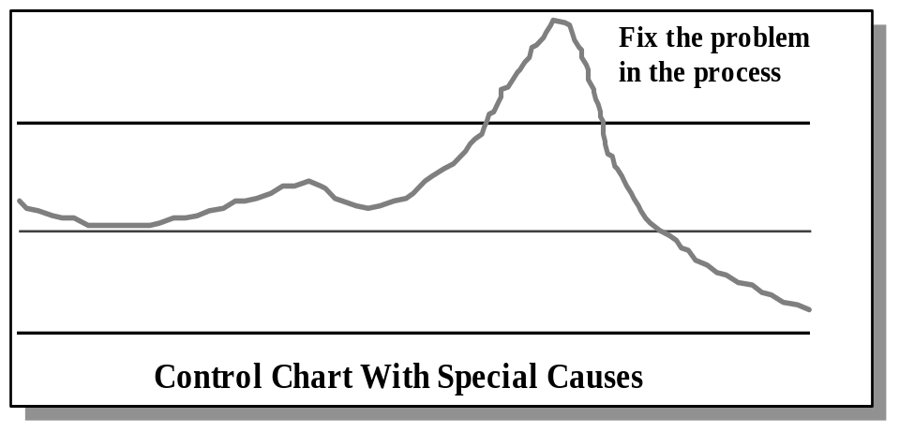
Characteristics of the Managed Level
  The software process is under statistical control.
  Quantitative quality goals for products are established and met.
  Strong knowledge and use of metrics and statistical techniques throughout the organization.
  Schedule and quality performance is predictable.
  Process improvement initiative belongs to the projects.

Slide 211
Managed Level (4) Key Process Areas
[from SEI-93-TR-25, "Key Practices of the Capability Maturity Model, Version 1.1"]
Quantitative Process Management.
Software Quality Management.
Notes:
Quantitative Process Management is the central KPA at Level 4

Slide 212
CMM Level 4
Quantitative Process Management

Slide 213
Quantitative Process Management Purpose
[from SEI-93-TR-25, "Key Practices of the Capability Maturity Model, Version 1.1"]
The purpose of Quantitative Process Management is to control the process performance of the software project quantitatively.
Software process performance represents the actual results achieved from following a software process.

Slide 214
Quantitative Process Management Goals
[from SEI-93-TR-25, "Key Practices of the Capability Maturity Model, Version 1.1"]
The goals of Quantitative Process Management are:
  The Quantitative Process Management activities are planned;
  The process performance of the project’s defined software process is controlled quantitatively;
  The process capability of the organization’s standard process is known in quantitative terms.

Slide 215
Quantitative Process Management
[from SEI-93-TR-25, "Key Practices of the Capability Maturity Model, Version 1.1"]
An organization-wide measurement program exists, including: a coordinating group and organization-wide measurement definitions, data collection, and analysis.
Goals of the measurement program are tied to the organization’s strategic goals for product quality, productivity, and development cycle time.
Process metrics are chosen from the entire software life cycle and applied consistently across projects:
  The specific measurement data to be collected;
  The intended use of each measurement;
  How each measurement will be analysed;
  The process points at which each measurement will be collected.

Slide 216
Quantitative Process Management - 2
[from SEI-93-TR-25, "Key Practices of the Capability Maturity Model, Version 1.1"]
Acceptable limits for each project’s measurements are defined and adjustments are periodically made to bring the actual performance in line with the defined acceptable limits.
The process capability of the organization’s standard software process is understood quantitatively.
Process capability trends are examined to predict likely downstream problems or opportunities for improvements.
Process measurement activities are reviewed by management on a regular basis.

Slide 217
CMM Level 4
Software Quality Management

Slide 218
Software Quality Management
Purpose
[from SEI-93-TR-25, "Key Practices of the Capability Maturity Model, Version 1.1"]
The purpose of Software Quality Management is to develop a quantitative understanding of the quality of the project's software products and achieve specific quality goals.

Slide 219
Software Quality Management
Goals
[from SEI-93-TR-25, "Key Practices of the Capability Maturity Model, Version 1.1"]
The project’s Software Quality Management activities are planned;
Measurable goals for software product quality and their priorities are defined;
Actual progress toward achieving the quality goals for the software products is quantified and managed.

Slide 220
Software Quality Management
[from SEI-93-TR-25, "Key Practices of the Capability Maturity Model, Version 1.1"]
The quality characteristics of each software product are identified:
  Reliability, usability, maintainability, performance.
Measurable product quality goals are established and maintained for each software project:
  Based on the needs of the organization, customer, and end users.
Each project’s plans and processes are designed to achieve it’s product quality goals.

Slide 221
Software Quality Management - 2
[from SEI-93-TR-25, "Key Practices of the Capability Maturity Model, Version 1.1"]
Actual product quality is monitored and corrective action is taken when actual measured quality is below the project’s quality goals.
The activities for managing quality are reviewed with senior management on a regular basis.

Slide 222
Level 4 KPA Relationships
intra/inter-project
process measurements
(special causes of
variation)
Software
Quality
Management
Quantitative
Process
Management
product measurement
customer satisfaction
(drives process
requirements)

Slide 223
CMM Level 5
The Optimizing Level

Slide 224
Characteristics of the Optimizing Level
Process improvement belongs to individuals.
Major process improvements justified by ROI.
Change is institutionalised.
The organization pursues the state-of-the-art in software engineering.
Process capability continuously increases.

Slide 225
Juran Trilogy
J.M. Juran Wilton, CT Used with the express permission of the Juran Institute, Aug, 1990.
Quality planning
Quality control (during operations)
Sporadic
spike
Original zone of
quality control
Cost of poor quality
Chronic waste
New zone of
Quality control
Quality improvement
Time
Lessons learned

Slide 226
Optimizing Level (5) Key Process Areas
[from SEI-93-TR-25, "Key Practices of the Capability Maturity Model, Version 1.1"]
Process Change Management.
Defect Prevention.
Technology Change Management.
Notes:
Process Change Management is the central KPA at Level 5

Slide 227
CMM Level 5
Process Change Management

Slide 228
Process Change Management
Purpose
[from SEI-93-TR-25, "Key Practices of the Capability Maturity Model, Version 1.1"]
The purpose of Process Change Management is to continually improve the software processes used in the organization with the intent of improving software quality, increasing productivity, and decreasing the cycle time for product development.

Slide 229
Process Change Management
Goals
[from SEI-93-TR-25, "Key Practices of the Capability Maturity Model, Version 1.1"]
The goals of Process Change Management are:
  Continuous process improvement is planned;
  Participation in the organization’s software process improvement activities is organization wide;
  The organization’s standard software process and the project’s defined software processes are improved continuously.

Slide 230
Process Change Management
[from SEI-93-TR-25, "Key Practices of the Capability Maturity Model, Version 1.1"]
Process improvement goals and plans are established and evaluated with senior management participation on a regular basis.
The organization’s software process improvement goals and accomplishments reflect its business goals and operating plans.

Slide 231
Process Change Management - 2
[from SEI-93-TR-25, "Key Practices of the Capability Maturity Model, Version 1.1"]
An organization-wide program to improve the software process is established which encourages and empowers the organization’s staff and managers to improve their own processes and to use improvements made by others.
An organizational procedure is followed for reviewing, approving, planning, implementing, and tracking process improvement proposals.
Some improvements are piloted before general use to evaluate benefits and effectiveness.

Slide 232
Process Change Management - 3
[from SEI-93-TR-25, "Key Practices of the Capability Maturity Model, Version 1.1"]
Consultation support is established before installing a process change throughout the organization.
The organization’s staff and managers receive feedback on a regular basis on the status and results of the process improvement activities.
Measurements are made and used to determine the status of the process improvement activities.

Slide 233
CMM Level 5
Defect Prevention

Slide 234
Defect Prevention
Purpose
[from SEI-93-TR-25, "Key Practices of the Capability Maturity Model, Version 1.1"]
The purpose of Defect Prevention is to identify the causes of defects and prevent them from recurring.

Slide 235
Defect Prevention
Goals
[from SEI-93-TR-25, "Key Practices of the Capability Maturity Model, Version 1.1"]
The goals of Defect Prevention are:
  Defect Prevention activities are planned;
  Common causes of defects are sought out and identified;
  Common causes of defects are prioritised and systematically eliminated.

Slide 236
Defect Prevention
[from SEI-93-TR-25, "Key Practices of the Capability Maturity Model, Version 1.1"]
At the beginning of each major task in a software project, project members that will be performing the task review the task activities in light of documented, related, Defect Prevention actions.
During and after a task is completed:
  Defects are identified and analysed to determine their root cause;
  Trends that indicate far reaching problems are identified;
  Proposed actions to prevent the future occurrence of identified defects are developed and documented in a process database.

Slide 237
Defect Prevention - 2
[from SEI-93-TR-25, "Key Practices of the Capability Maturity Model, Version 1.1"]
Teams assigned to facilitate Defect Prevention activities meet on a regular basis to review action proposals.
The organization’s standard software process and the projects’ defined software processes are revised periodically based on the accepted Defect Prevention action proposals.

Slide 238
CMM Level 5
Technology Change Management

Slide 239
Technology Change Management
Purpose
[from SEI-93-TR-25, "Key Practices of the Capability Maturity Model, Version 1.1"]
The purpose of Technology Change Management is to identify new technologies (i.e., tools, methods, and processes) and track them into the organization in an orderly manner.

Slide 240
Technology Change Management
Goals
[from SEI-93-TR-25, "Key Practices of the Capability Maturity Model, Version 1.1"]
The goals of Technology Change Management are:
  Incorporation of technology changes are planned;
  New technologies are evaluated to determine their effect on quality and productivity;
  Appropriate new technologies are transferred into normal practice across the organization.

Slide 241
Technology Change Management
[from SEI-93-TR-25, "Key Practices of the Capability Maturity Model, Version 1.1"]
The organization funds and staffs a group to focus on Technology Change Management:
  Maintains an awareness of software technology innovations and systematically identifies, evaluates, and experiments with them.
The organization’s and projects’ staff and managers are kept aware of any appropriate new technologies.
The organization selects appropriate technologies to improve productivity and product quality.

Slide 242
Technology Change Management - 2
[from SEI-93-TR-25, "Key Practices of the Capability Maturity Model, Version 1.1"]
The organization’s standard software process is systematically analysed to identify areas that could benefit from new technology.
Pilot efforts are performed to assess new and unproven technologies before they are introduced across the organization.
Selected technologies are incorporated into the organization’s processes.
Appropriate sponsorship is provided.

Slide 243
Level 5 KPA Relationships
Technology
Change
Management
culture &
Infrastructure
to facilitate
changes
culture &
Infrastructure
to facilitate
changes
Defect
Prevention
Process
Change
Management
Process
Change
Requests
Process
Change
Requests
Changes
to process
changes to
process

Slide 244
Software Process Improvement
The Role of Senior Management
in Process Improvement

Slide 245
The Role of Senior Management in Process Improvement Objectives
Describe the role of senior management necessary to support continuous process improvement
  Examine the Process Improvement Model
  Examine what the CMM suggests senior management should be doing

Slide 246
Process Improvement Model (PIM)
2
Appraisal
of the
Software Process
3
1
Infrastructure
and Plans for
Software Process
Improvement
Commitment
to
Software Process
Improvement
4
Implementation
of
Software Process
Improvements
Notes:
The ISPI Process Improvement Model is intended to show continuous process improvement. The main blocks of the model are:
Commitment to Software Process Improvement - The management team understands the process improvement process and commitments people, time, and other resources as needed toward its successful execution.
Appraisal of the Software Process - An appraisal of the organization’s software process takes place to determine what the current software process is (What is Documented and what is happening in the Practice).
Infrastructure and Plans for Software Process Improvement - The organizational software process improvement effort infrastructure is put into place and the action plans for the improvement effort are developed
Implementation of Software Process improvements - The actual implementation of the action plans takes place

Slide 247
PIM: Commitment
Senior Management Support
  Sponsor, encourage and attend an Executive Briefing and/or Software Process Improvement Seminar
  Encourage managers and staff to become familiar with process improvement concepts through books, seminars, conferences and courses
1
Commitment
to
Software Process
Improvement
Notes:
1) Commitment
• Investigation and training - Commitment to a new idea or process usually starts with some form of investigation. Books,articles, presentations, and internal discussion in some combination usually take place as the person or organization begin to understand and these new ideas
• Expectation Setting - One of the most important concepts in process improvement is that of Expectation Setting. It is ISPI’s belief that you can almost not put too much effort into expectation setting. This is true for all levels of management and practitioners.
What are the costs and benefits of committing

Slide 248
PIM: Commitment – 2
Senior Management Support
  If organization's vision is not defined, define it
  If organization's vision has not been shared throughout the organization disseminate it
  Show visible commitment to process improvement
  Ask for sponsorship from direct reports, with cascading sponsorship the goal
  Expect (and deal with) resistance
1
Commitment
to
Software Process
Improvement
Notes:
1) Commitment
• Investigation and training - Commitment to a new idea or process usually starts with some form of investigation. Books,articles, presentations, and internal discussion in some combination usually take place as the person or organization begin to understand and these new ideas
• Expectation Setting - One of the most important concepts in process improvement is that of Expectation Setting. It is ISPI’s belief that you can almost not put too much effort into expectation setting. This is true for all levels of management and practitioners.
What are the costs and benefits of committing

Slide 249
PIM: Appraisal - 3
2
Appraisal
of the
Software Process
Senior Management Support
  Provide resources and support for an appraisal of the organization’s process (assessment)
  Be available for the On-Site Period (Opening Meeting, Findings and Recommendations Briefing, and Executive Session)
  Sponsor Action Planning, ensure right people are involved

Slide 250
PIM: Infrastructure and Plans
Senior Management Support
  Consider participation in collaborative consulting training
  Approve charter and organization position of Software Engineering Process Group (SEPG)
  Ensure adequate staffing of SEPG (both quantity and capabilities)
  Approve training in process improvement techniques for those that will facilitate it
3
Infrastructure
and Plans for
Software Process
Improvement
Notes:
3) Infrastructure
• Define and staff a process improvement group - Identify full time and part time process group members. Set up the Process Improvement Infrastructure including the Senior Management Advisory Board, the Steering Committee, the SEPG, and the Working Groups. Clearly define the roles and responsibilities of each part of the Infrastructure and set expectations
• Train Improvement Staff - Provide the SEPG and the Working Groups with necessary background and process improvement training in topics such as team skills, collaborative consulting, managing change, and improvement planning.
• Plan the Improvement Process- Treat the process improvement effort as if it were the organization’s most important project. This means that it must be planned, with people, resources, milestones, measurement criteria, management reviews, configuration management, and quality assurance

Slide 251
PIM: Implementation
Senior Management Support
  Facilitate involvement of all required groups in planning and implementation
  Provide necessary inputs to action planning team (e.g. business issues, financial constraints, market issues)
  Insist on regular visible status reports on process improvement activities
  Treat Process Improvement like any other high priority project
4
Implementation
of
Software Process
Improvements
Notes:
4) Implementation
• Define new processes- Review and revise existing processes as necessary. Define those process in collaboration with those that will use the process
• Pilot new processes - Establish a contract with a Pilot Project to implement these new processes on a real project. Provide ‘hand- holding support’ to ensure a successful trial
• Refine new processes- Gather lessons learned from the Pilot experience and refine the new processes as necessary. Determine if another pilot project is necessary or if the implementation on an organization wide basis can begin
• Assist in adoption of new processes - Assist the other projects in the organization to adopt the new processes into their daily work
• Institutionalization new processes - Institutionalize new processes through training, direct support, policies, and procedures

Slide 252
Sponsorship
Produce
Report
Form
and
Train
Team
Gather
Process
Data
Synthesize
Findings
Present
Findings
Visioning
Define & Staff
Improvement
Infrastructure
Identification
of Initial Staff
2 Appraisal
Expectation
Setting
Train
Improvement
Staff
PIM
Detail
1 Commitment
3 Infrastructure
Investigation
and Training
Plan
Improvement
Process
Institutionalise
New processes
4 Implementation
Assist in
adoption of
new processes
Refine new
processes
Pilot new
processes
Define new
processes
Notes:
Details of the ISPI Process Improvement Model:
Commitment
Investigation and training - Commitment to a new idea or process usually starts with some form of investigation. Books, articles, presentations, and internal discussion in some combination usually take place as the person or organization begin to understand and these new ideas
Expectation Setting - One of the most important concepts in process improvement is that of Expectation Setting. It is ISPI’s belief that you can almost not put too much effort into expectation setting. This is true for all levels of management and practitioners.
What are the costs and benefits of committing to a process improvement program?
What is required of senior management?
What is required of those who will be facilitating the process improvement effort?
What other related efforts are already in place?
Identification of improvement staff - Qualified individuals should be identified for the process group (SEPG). Qualified individuals should be identified for the appraisal as well. It is wise to ensure that at least two of the appraisal members will remain as part of the SEPG for continuity
Visioning - Where does senior management think the company will be in one year or five years? Who will the competitors be? Where will the company be ranked compared to its competitors? What will the organizational culture be like then?
Sponsorship - Senior Management sponsorship and support is critical to process improvement success. However, it is necessary to have cascading management sponsorship down to the practitioner level if the process improvement effort is to be successful
Appraisal
Form and train an appraisal team - Qualified individuals should be identified for the appraisal. Some of the attributes of appraisal team members include: At least 10 years of software engineering experience, knowledge of software support functions such as SQA and SCM, good communication skills, respected in the organization, team oriented, process champions, and enjoys working with other people
Gather process data- Whether it is through an assessment, an audit, or a process action team brainstorming session, a necessary part of the appraisal process is the gathering of data both from documented sources as well through interviews
Synthesize Findings- Information gathered through documentation evaluation and interviews with all levels of management and practitioners must be reviewed and the key process issues facing the organization must be brought forth
Present Findings and Recommendations - Finalize findings and generate recommendations - Brainstorm recommendation ideas with managers and practitioners .
Guidance for Action Planning - Provide input to senior management on what improvement actions should be undertaken and in what priority order - Provide the start of the action plan to the process group members
Infrastructure
Define and staff a process improvement group - Identify full time and part time process group members. Set up the Process Improvement Infrastructure including the Senior Management Advisory Board, the Steering Committee, the SEPG, and the Working Groups. Clearly define the roles and responsibilities of each part of the Infrastructure and set expectations
Train Improvement Staff - Provide the SEPG and the Working Groups with necessary background and process improvement training in topics such as team skills, collaborative consulting, managing change, and improvement planning.
Plan the Improvement Process- Treat the process improvement effort as if it were the organization’s most important project. This means that it must be planned, with people, resources, milestones, measurement criteria, management reviews, configuration management, and quality assurance
Implementation
Define new processes- Review and revise existing processes as necessary. Define those process in collaboration with those that will use the process
Pilot new processes - Establish a contract with a Pilot Project to implement these new processes on a real project. Provide ‘hand-holding support’ to ensure a successful trial
Refine new processes- Gather lessons learned from the Pilot experience and refine the new processes as necessary. Determine if another pilot project is necessary or if the implementation on an organization-wide basis can begin
Assist in adoption of new processes - Assist the other projects in the organization to adopt the new processes into their daily work
Institutionalization new processes - Institutionalize new processes through training, direct support, policies, and procedures

Slide 253
Improvement
Software process capability is expressed in terms of key process areas (KPAs)
Each KPA is implemented by activities of engineers or others
These implementation activities are enabled by other activities
  Commitment to Perform
  Ability to Perform
  Verifying Implementation
  Measurement and Analysis
Senior management’s roles are mainly in enabling the implementation

Slide 254
Responsibilities at Level 2
Specific Level 2 responsibilities suggested by the CMM in key process areas (Requirements Management, Project Planning, Project Tracking, Software Quality Assurance, Software Configuration Management, Subcontract Management)
Role in “Commitment to Perform” in these process areas
  Ensure that organization-wide policies are established and used
Role in “Ability to Perform”
  Ensure that adequate resources and funding are provided for activities

Slide 255
Responsibilities at Level 2 - 2
Role in “Verifying Implementation”
  Review, periodically and at appropriate level of abstraction, the activities being performed
  Typical content of reviews
    issues not resolvable at lower levels
    technical, cost, staffing, and schedule performance
  Ensure there is an exception reporting mechanism
  Ensure periodic review by project management

Slide 256
The Chief Tasks
In terms of the CMM, the principal responsibilities of managers are to
  Ensure that practices of the next level are achieved, that they add business value, and that they become institutionalised
  Keep the organization focused on higher process maturity as a goal
  Establish and sustain the strategic business role for software process improvement
  Support the software process improvement effort visibly
    with their presence
    with organization resources

Slide 257
A New Role for the Organization
A focus on process improvement may be a new direction for the organization
Long term, continuous process improvement may require a culture change
On the other hand, the new direction may be considered just the latest “quality” fad and many people may be slow to “buy in”
Your continued attention to the new focus will demonstrate to the organization that process improvement is here to stay

Slide 258
Process Improvement Seminar
Summary
Notes:
Summary is composed of slides 17:22 from SPA:MPC

Slide 259
Attributes of Successful Changes
Management Sponsorship
  Cascading
  Visible
  Time, money, resources
  Monitoring

Slide 260
Attributes of Successful Changes - 2
The change is consistent with the organization’s values, mission, and strategy
Buy-in
  Those affected by the change are involved in designing it

Slide 261
Attributes of Successful Changes - 3
Education and training are provided
  In the new technology or process
  In managing change concepts

Slide 262
Attributes of Successful Changes - 4
Communication is stressed
  Formal meetings, briefings, reviews
  Informal discussions
  Memos, newsletters
  Handbooks, mentoring, training

Slide 263
Attributes of Successful Changes - 5
Reward systems are modified
  Desired behaviour is rewarded
  Undesired behaviour is not rewarded
  Heroes are process performers, not fire-fighters
The change is planned and budgeted
  Goals and plans are realistic

Slide 264
Attributes of Successful Changes - 6
Long term commitment
  Worthwhile changes usually take a long time to implement
  Maintaining the change requires investment
  Maintenance is cheaper than a series of “crash” programs

Slide 265
Attributes of Successful Changes - 7
Champions
  Advocates for the change are necessary
  They should be cultivated and encouraged

Slide 266
Attributes of Successful Changes - 8
Walk your talk
  A process change is weakened every time it is waived for “business” or “organizational” or “personal” reasons
  Those sponsoring a change, should be prepared to use the same processes, if applicable

Slide 267
Summary
Change is harder than we think
  It takes longer and costs more
  People resist
  Most organizations are very complex systems
Successful process changes are possible, with appropriate planning and management

Slide 268
Questions and Answers

